Slide 1




SOCCER ALLIANCE
Soccer Management App
Cégep de la Gaspésie et des Îles

Slide 2
SOCCER ALLIANCE
MAD~311
Yash Modi | 1894082
Parag Dangariya | 1894264
Monika Upadhyay | 1894220
Saurabh Jain | 1894017
Farhin Vahora | 1894132
Ami Parekh | 1894192
Prepared By:

Slide 3

Guided by:
Project Coordinator:
Pargol Poshtareh
Olivier Melançon
Sakshi Sharma
Harsh Divecha
Navpreet Kaur

Slide 4
Table of Contents
Introduction
Soccer Alliance Application Features
Use Case Model & Class Diagram
Difficulties Overcame
Future Enhancements
Soccer Alliance App Video Link

Slide 5
Introduction
Soccer Alliance is a Soccer Management Application gives
users an opportunity to manipulate the soccer team or
league.
Allow users to create, delete & update data for League
Allow users to create, update data of a Soccer Team
Allow users to view different data for team and league
Built using Android Studio & MySQL
Mandatory OS : Android
Android Version Requirement : Android 5.1 or higher

Slide 6
Soccer Alliance Application Features
Guest User
Team Manager
League Manager
View Leagues & Teams
View Teams of the League
View Player List of the Team
View List of Country
View all the Teams
View Upcoming Matches
View Matches details
View Played Matches
View Scores & Statistics
They must create account
They could reset password
They must create one team
They must add new players to the team
They could remove players to the team
They could update player information
They could view players of their own team
They could update their team’s profile
They could update their own profile
They could view all leagues and teams
They could view Upcoming Matches
They could view Match details
They could view Played Matches
They could view Scores & Statistics
They could create account
They could reset password
They could create league
They have access to all the teams
They could add team to league
They could remove team from league
They could schedule matches
They could reschedule matches
They could cancel matches
They could add score of the match
They could update scores & statistics
They could update their own profile
They could view all leagues and teams
They could view Upcoming Matches
They could view Match details
They could view Played Matches
They could view Scores & Statistics

Slide 7
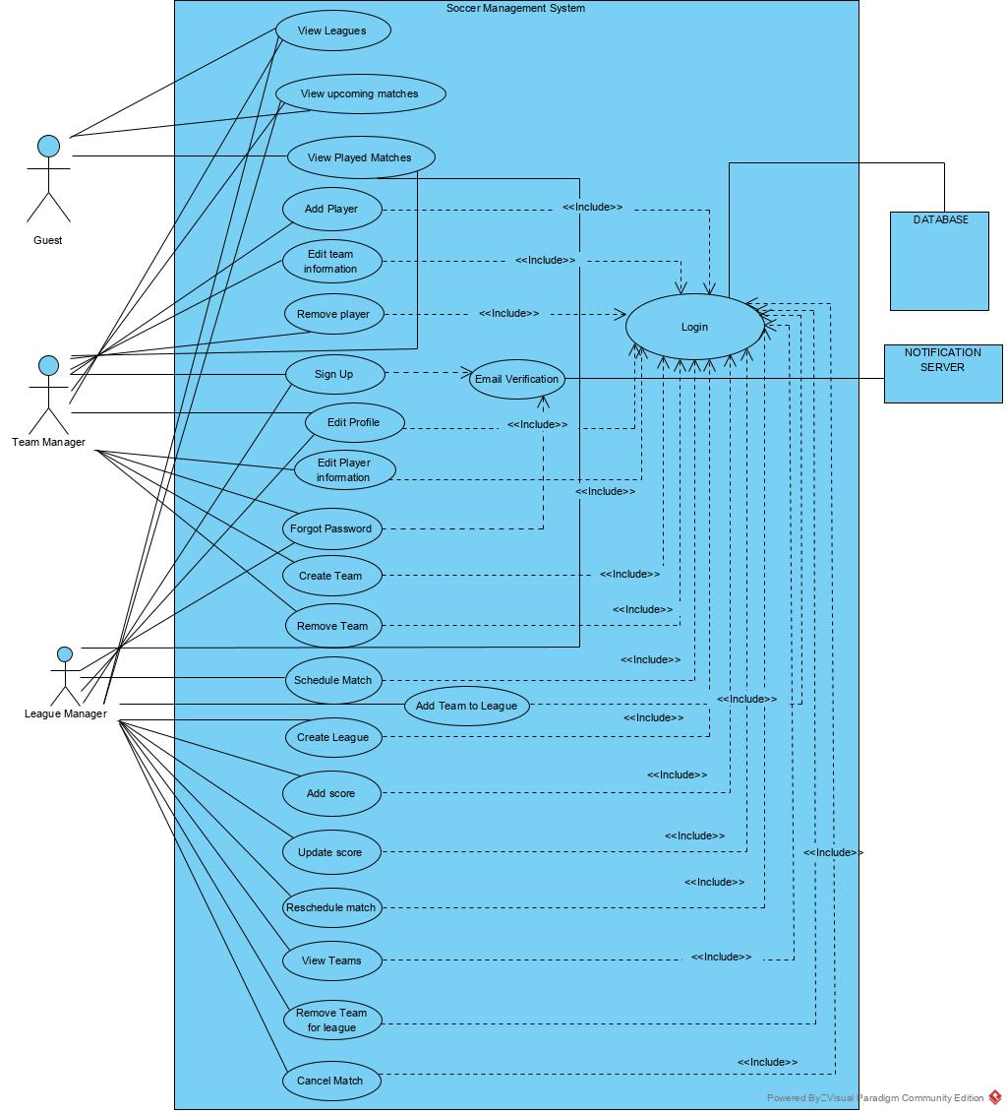
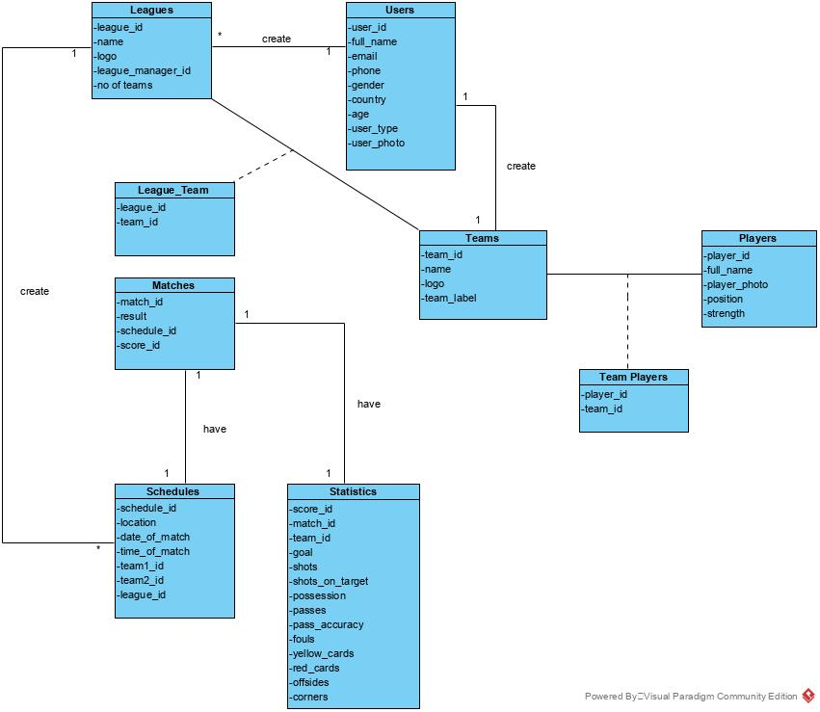
Use Case Diagram
Class Diagram

Slide 8
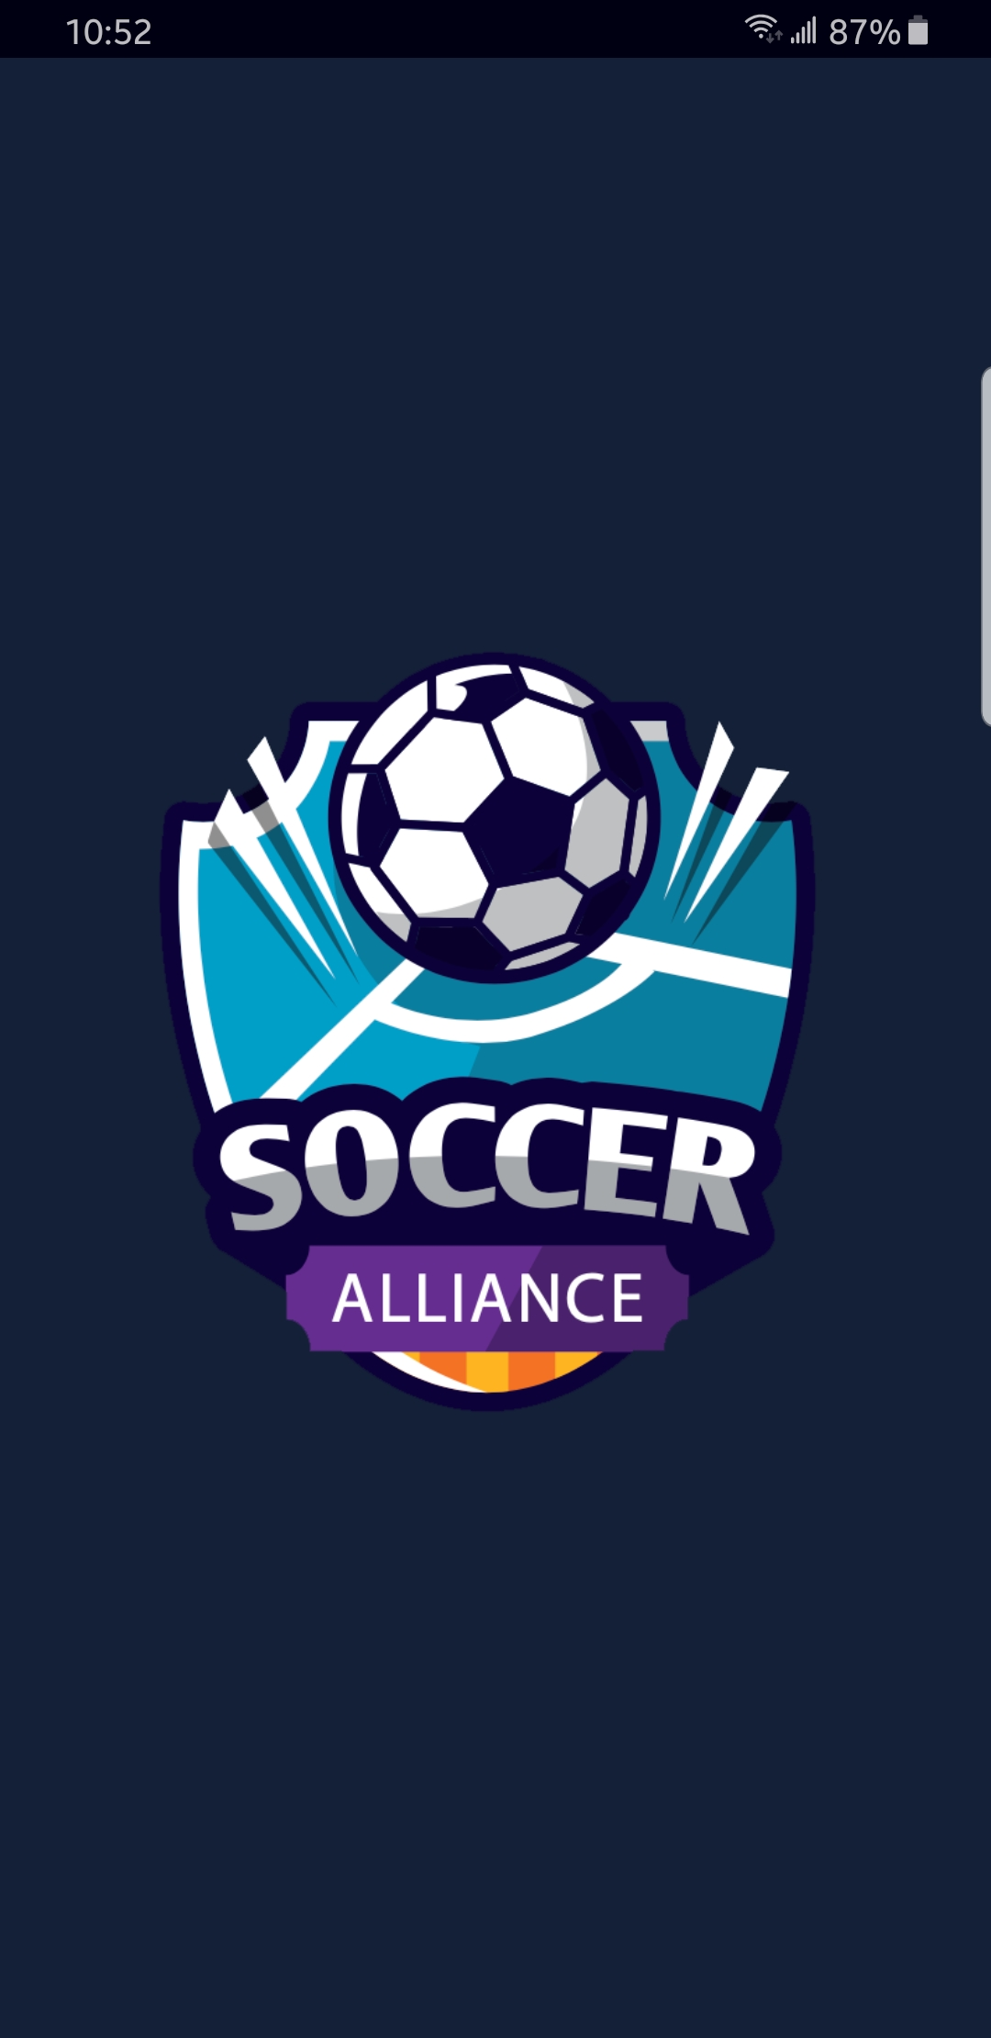
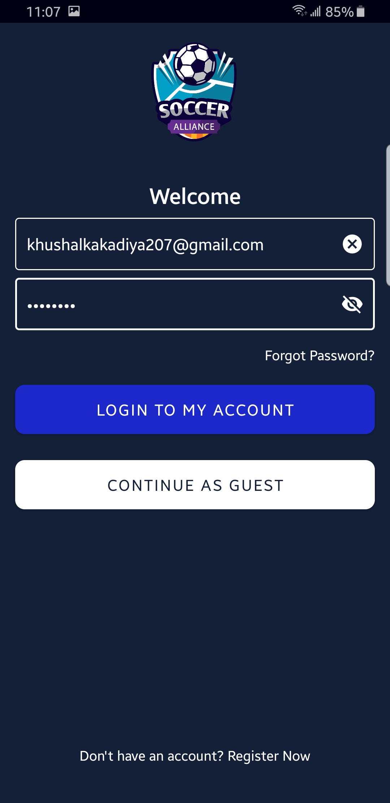
Splash Screen

Slide 9
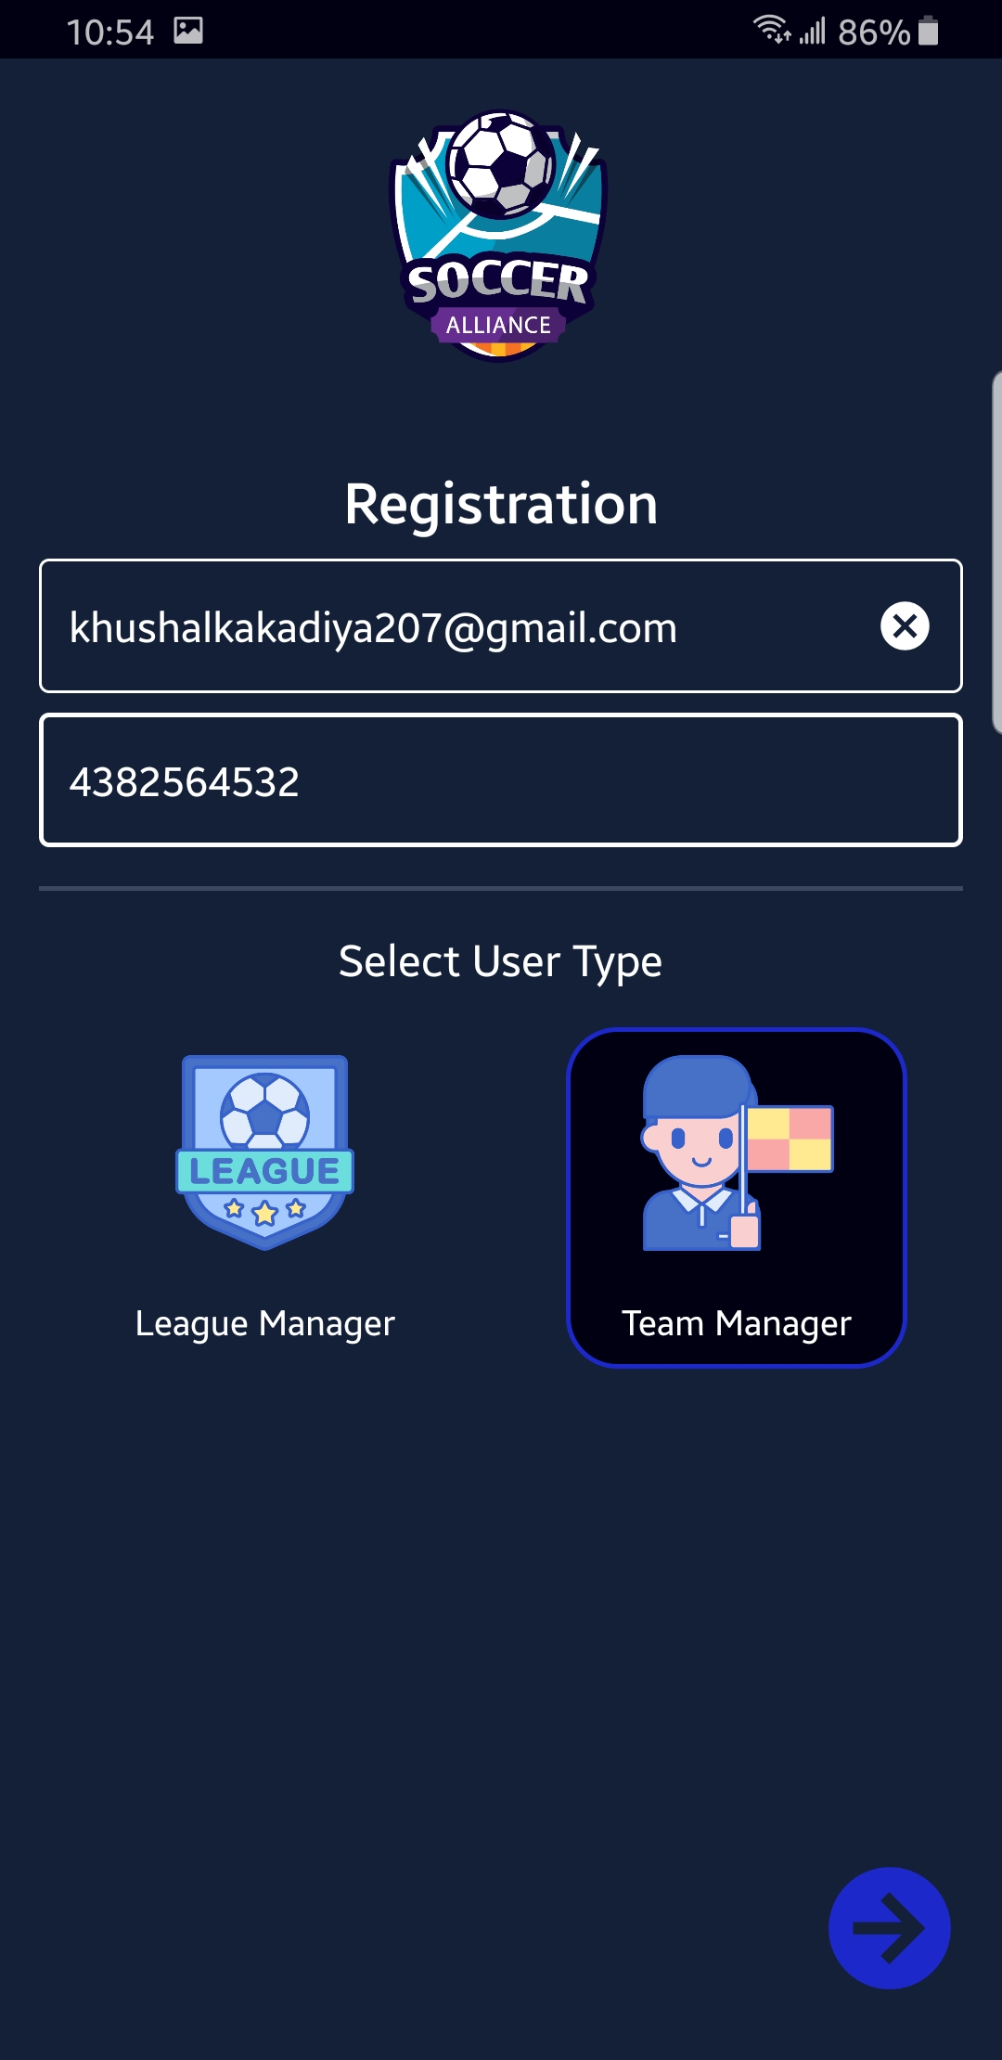
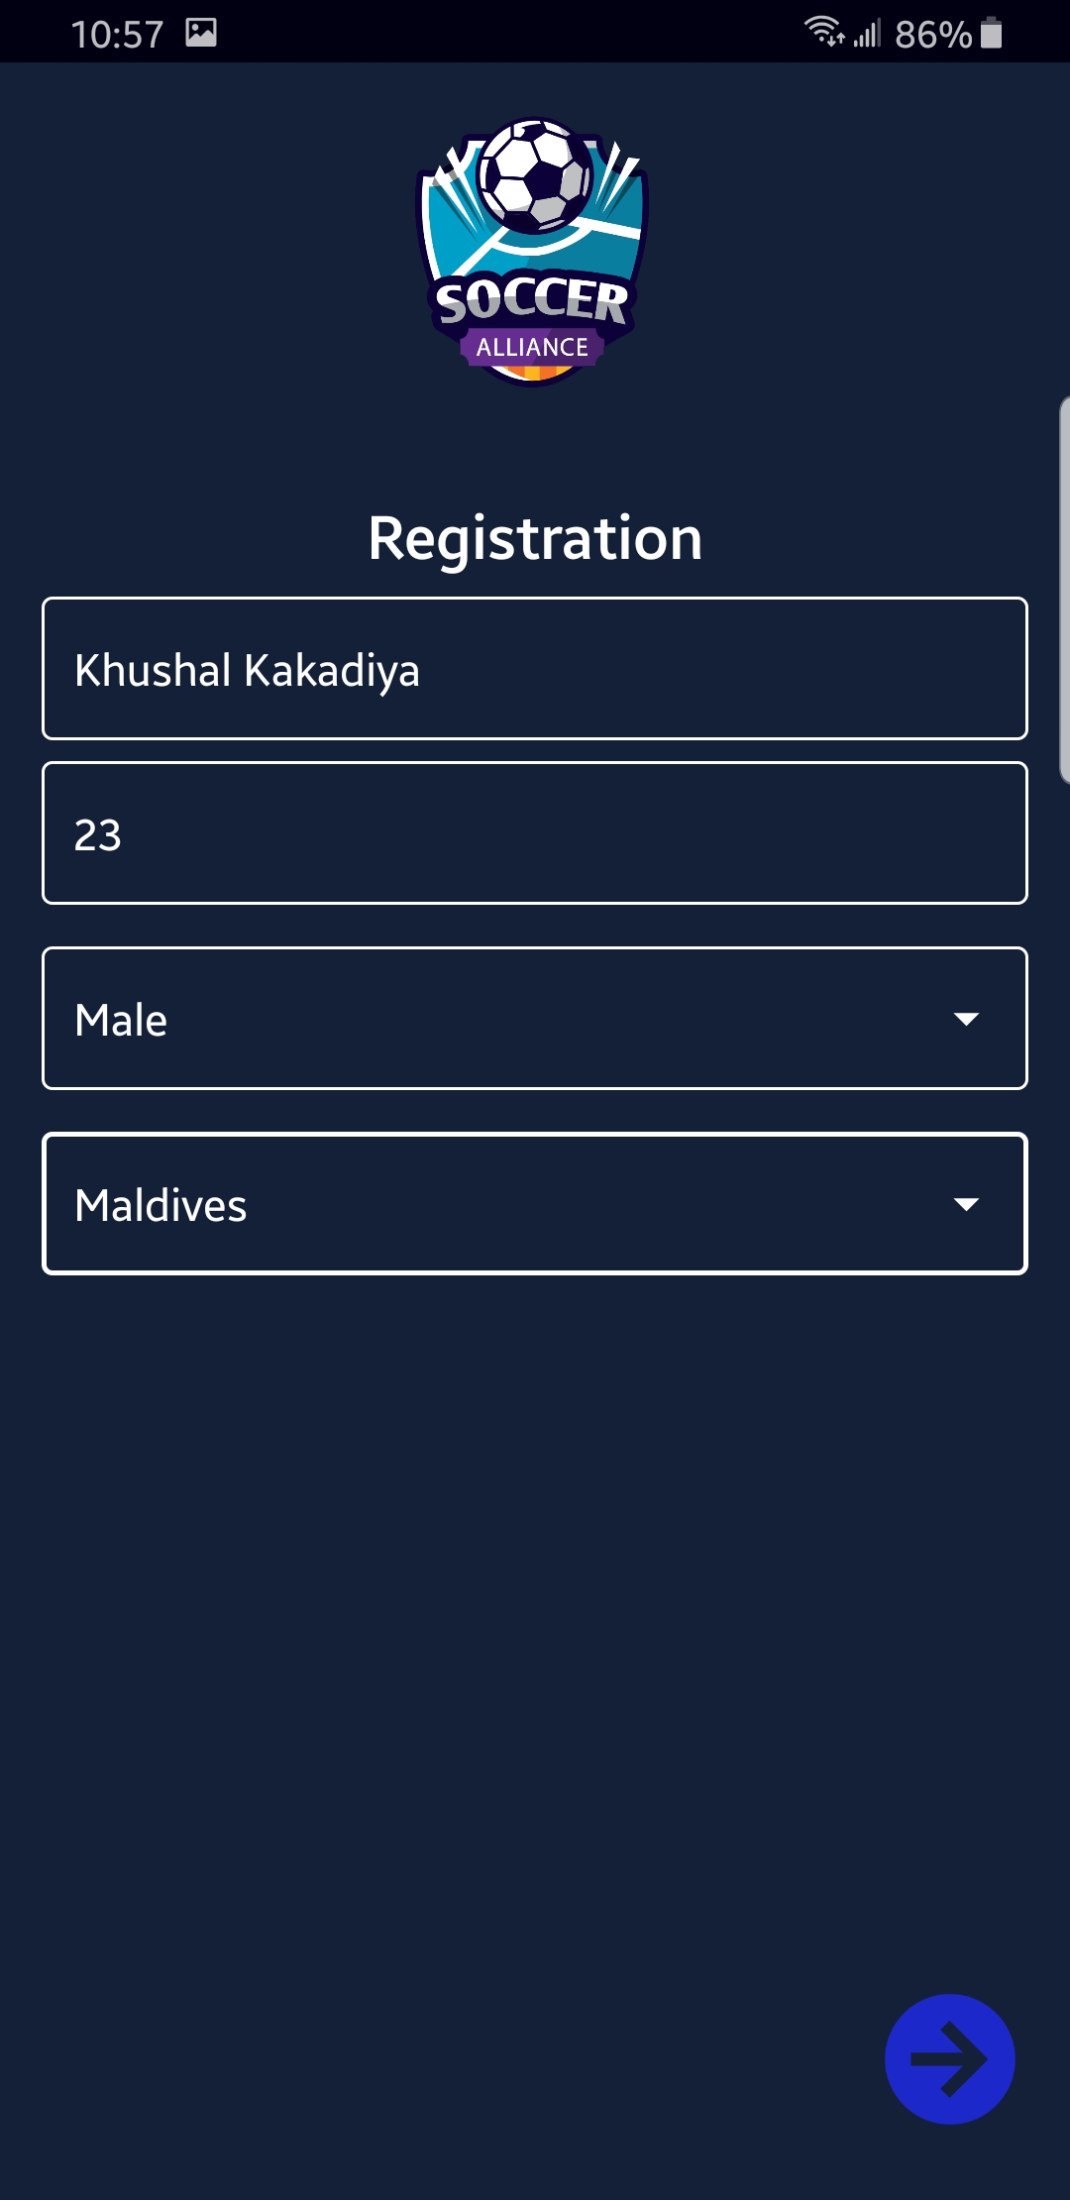
Registration Screen
Mandatory
Parameters:
User’s email id
Phone Number
User Type
Name
Age
Gender
Country

Slide 10
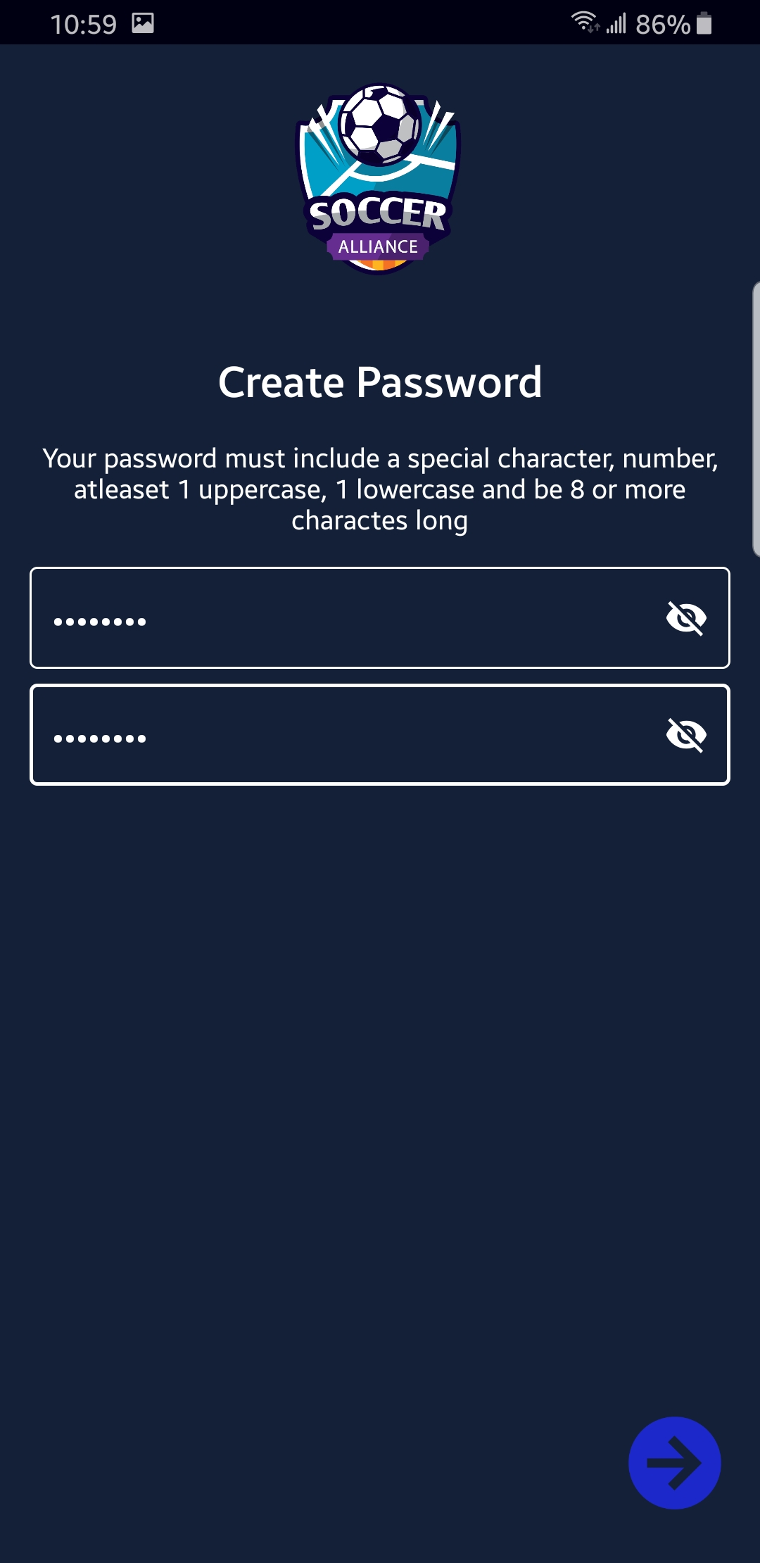
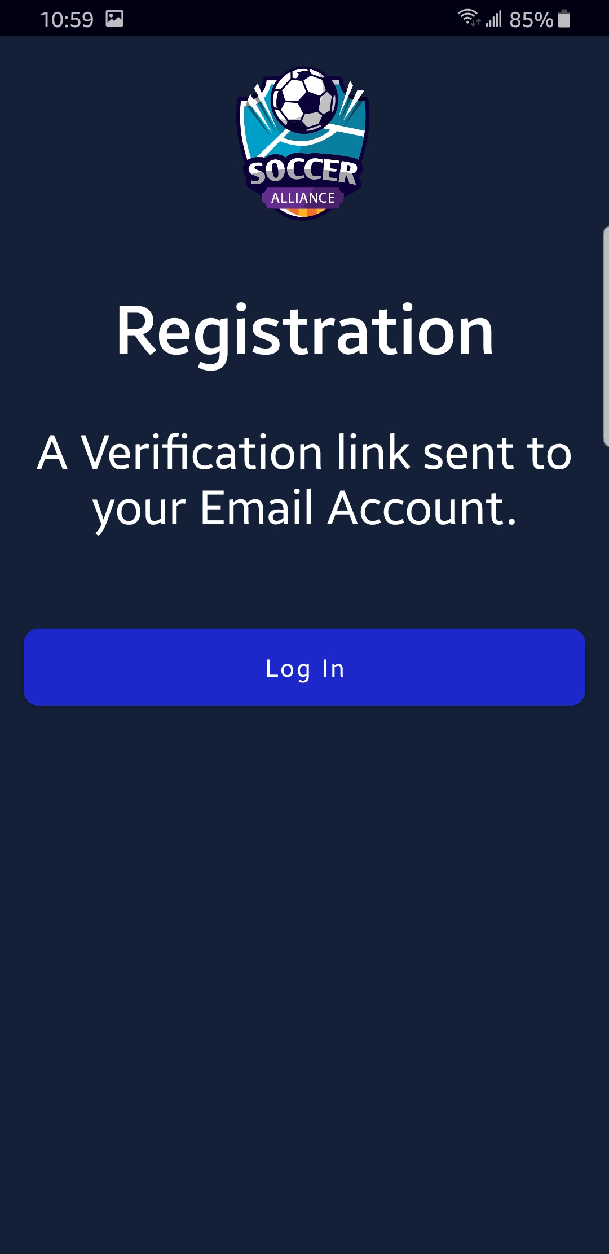
Create Password Screen
Parameter:
Password should contain minimum 6 characters.

Slide 11
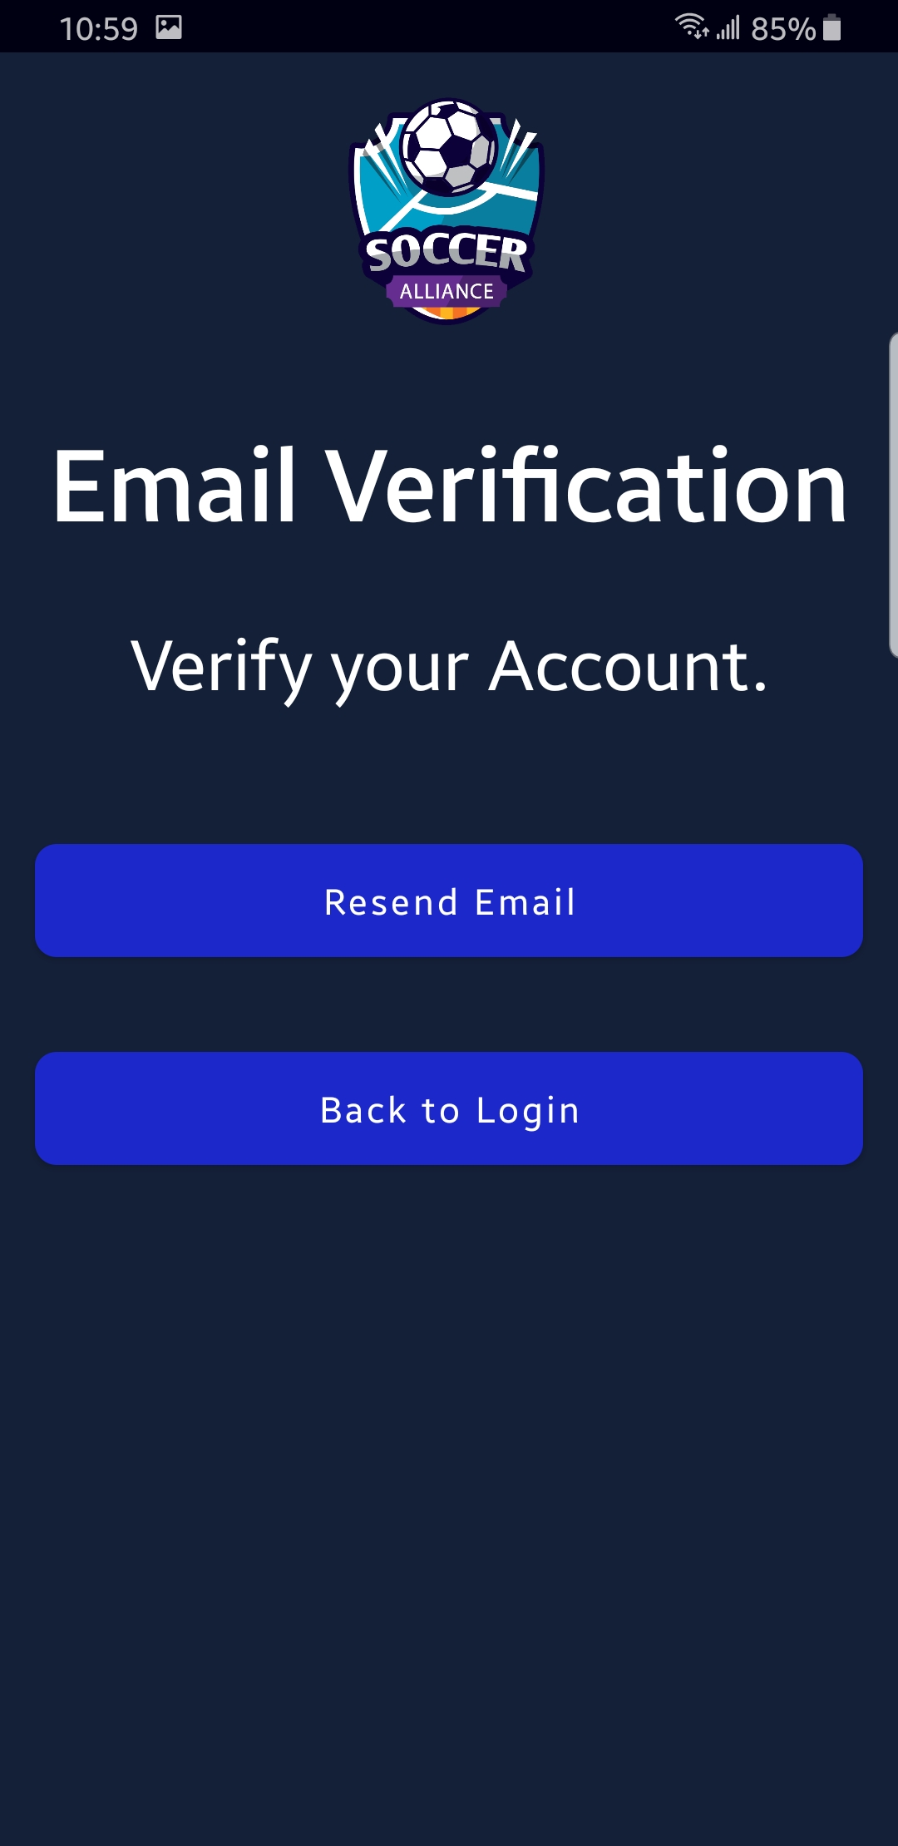
Verification Screen
Parameters:
No parameters
Result:
Redirect to login screen

Slide 12
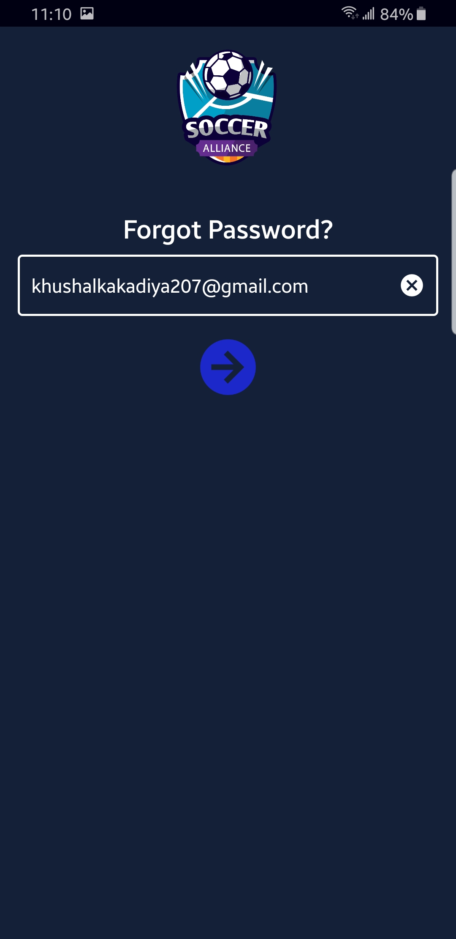
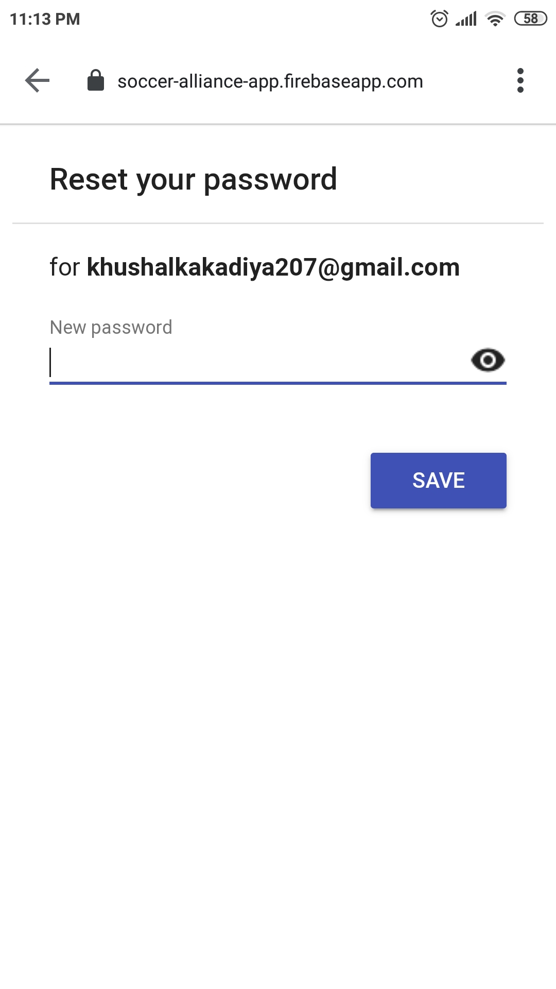
Forgot Password Screen
Parameter:
Email ID
Result:
Redirect to reset password webpage.

Slide 13
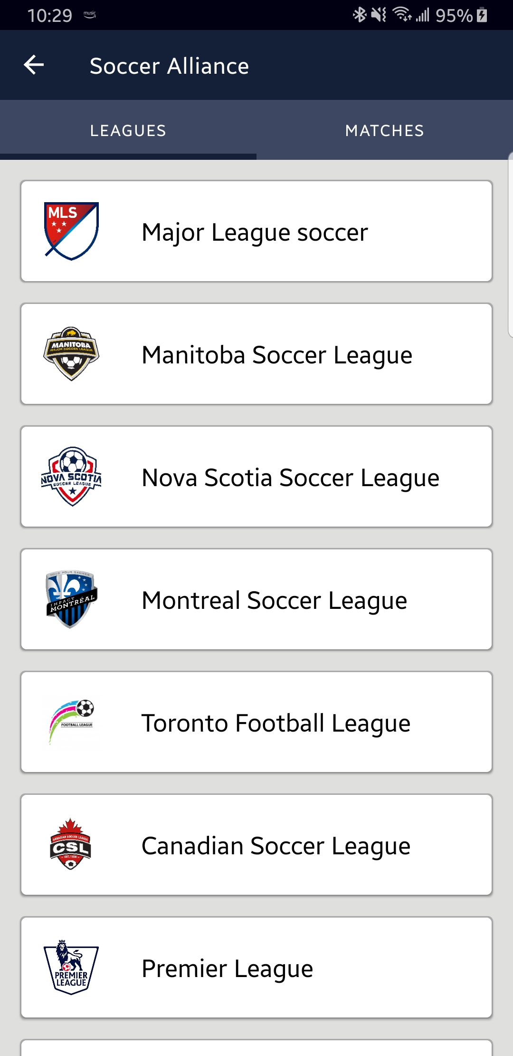
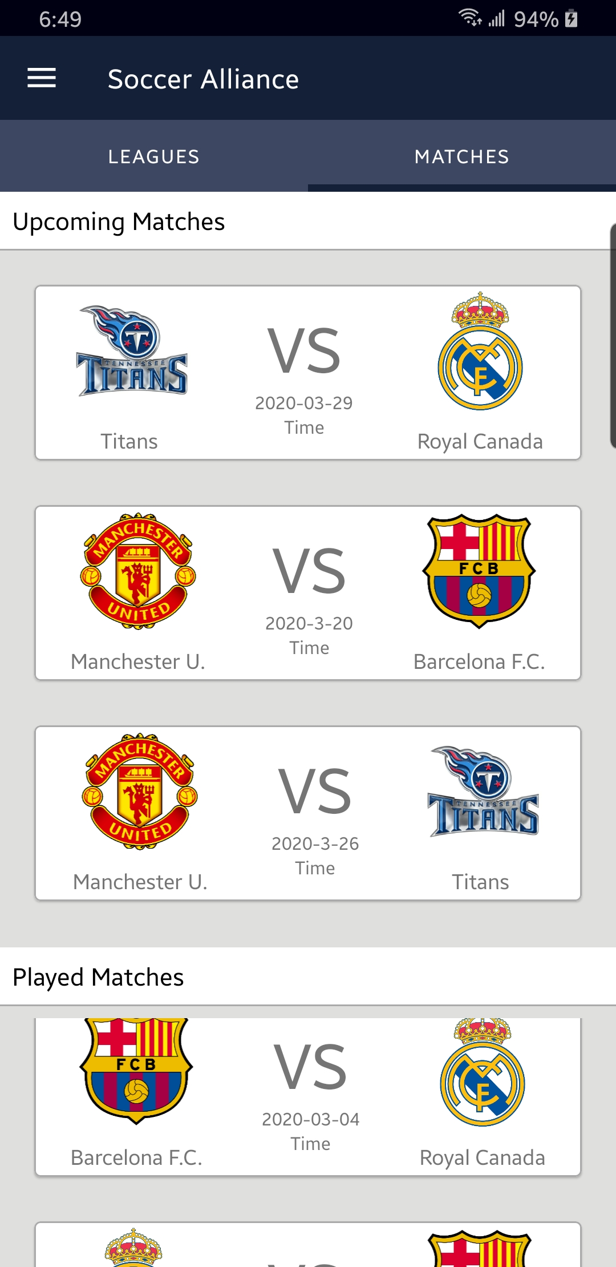
Dashboard Screen Tabs
Leagues:
Displays list of leagues
Matches:
Displays list of Upcoming and Played Matches

Slide 14
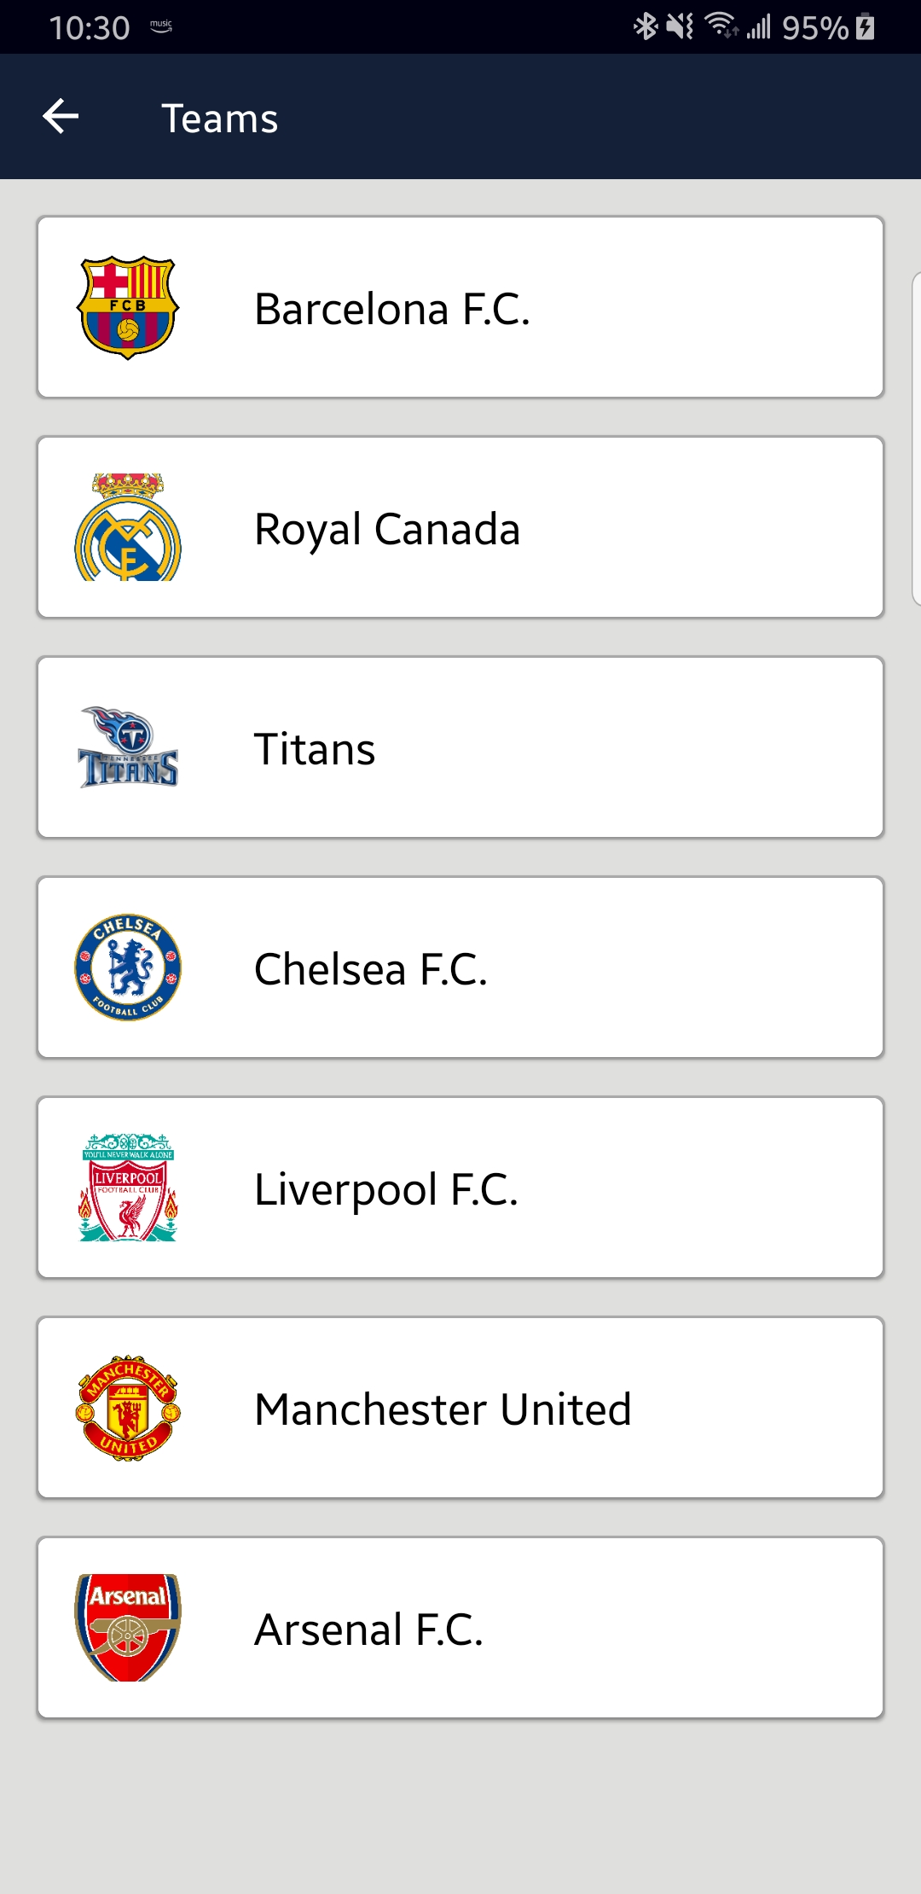
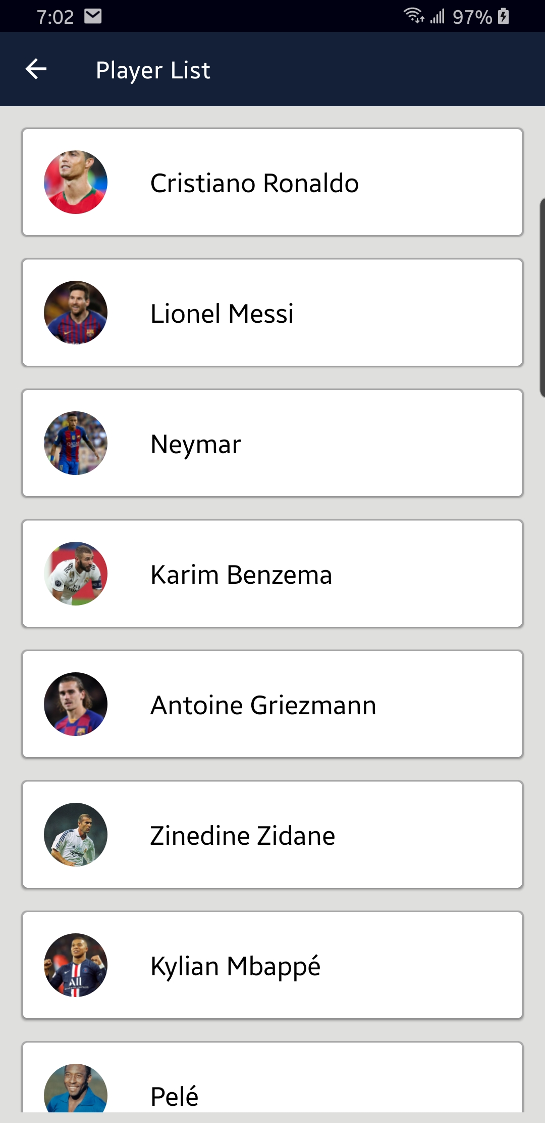
Guest User

Slide 15
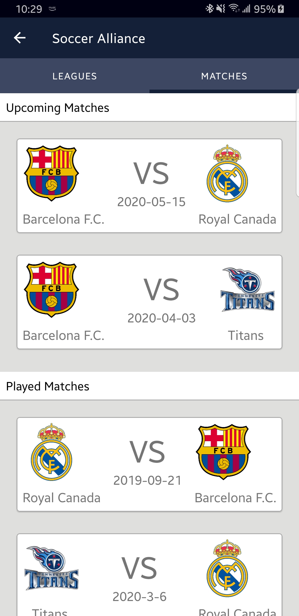
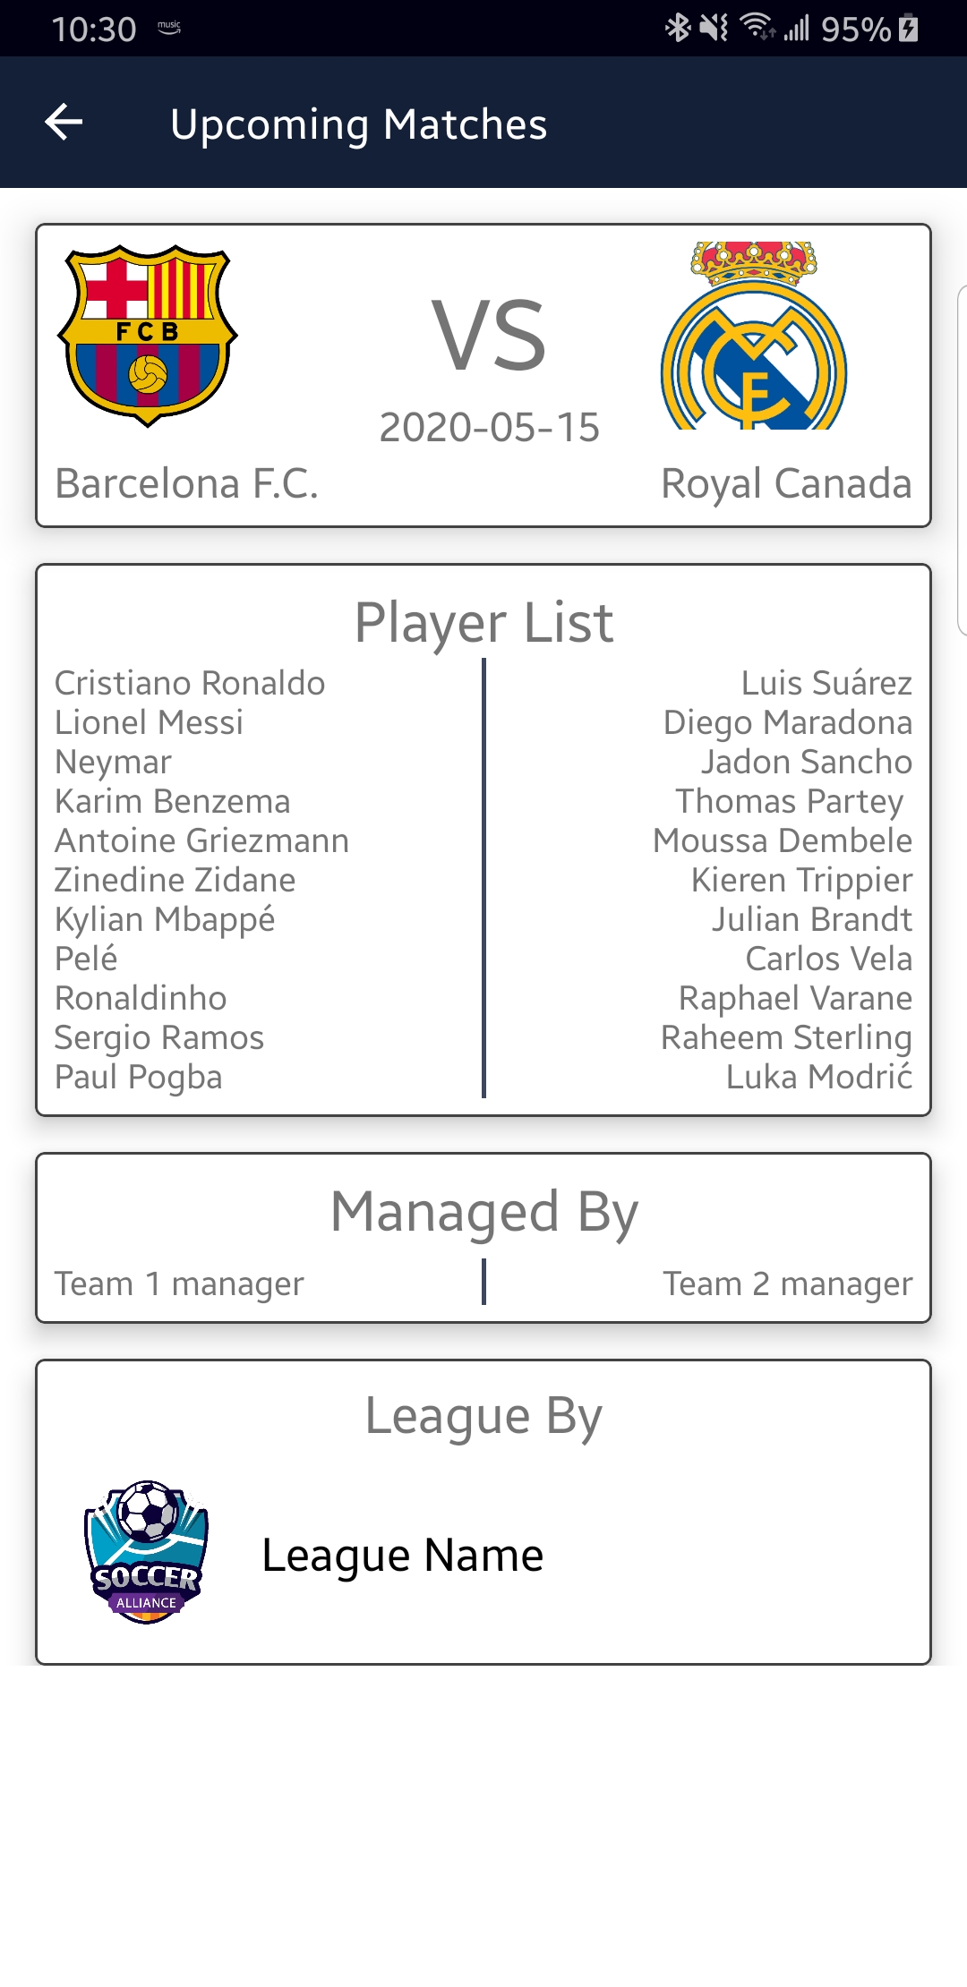

Slide 16
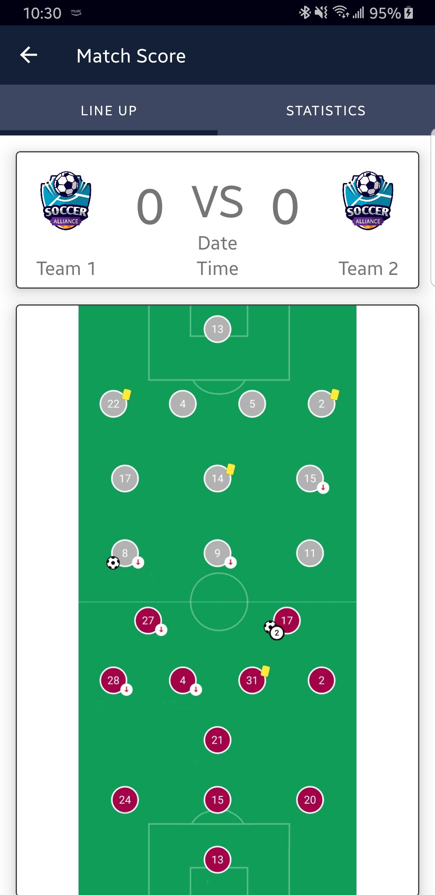

Slide 17
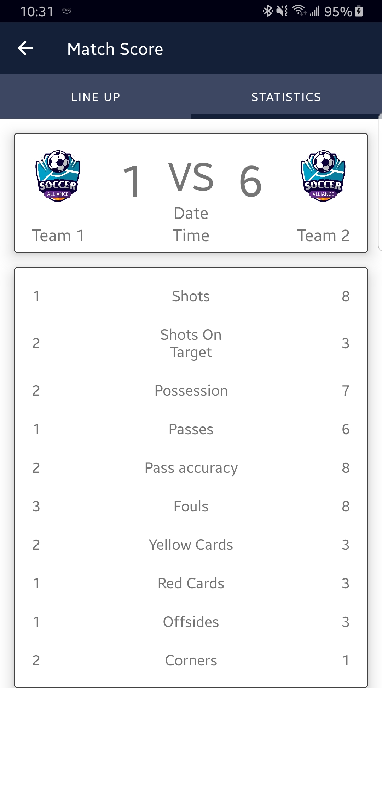

Slide 18
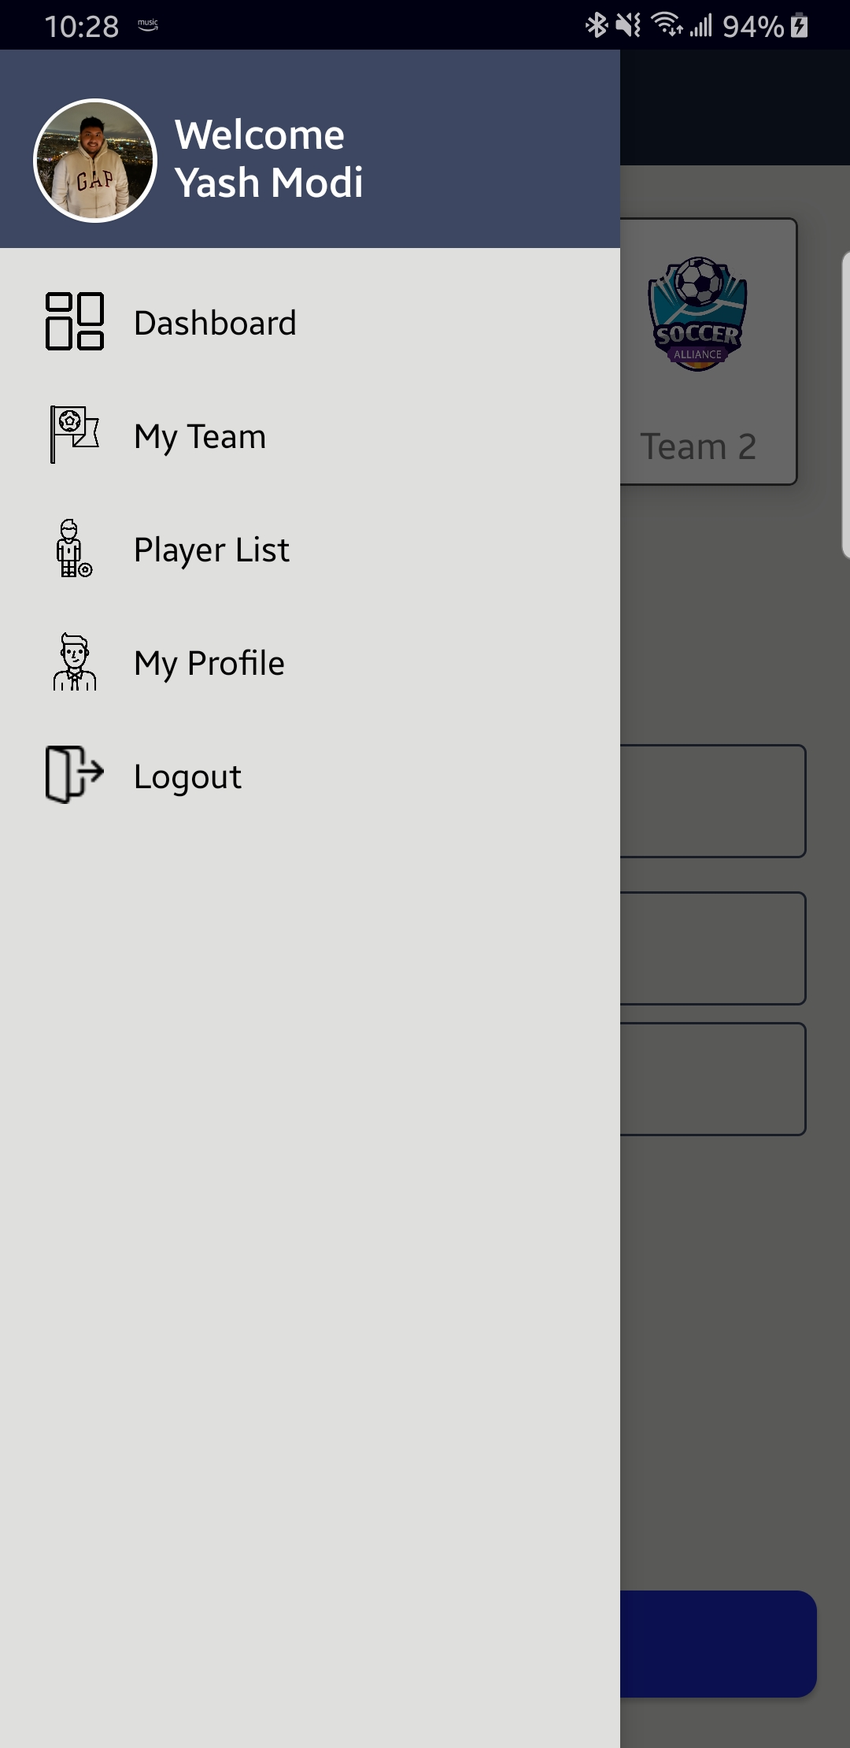
Team Manager Drawer Screen
My Team displays the list of teams.
Player list displays the list of players from database.
My Profile let’s the user to edThey user’s profile.

Slide 19
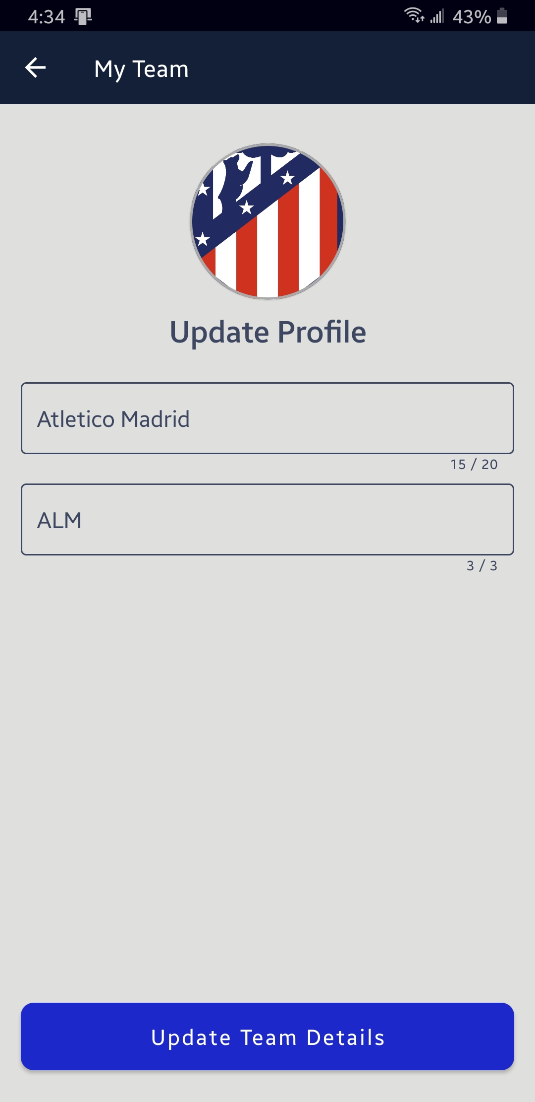

Slide 20
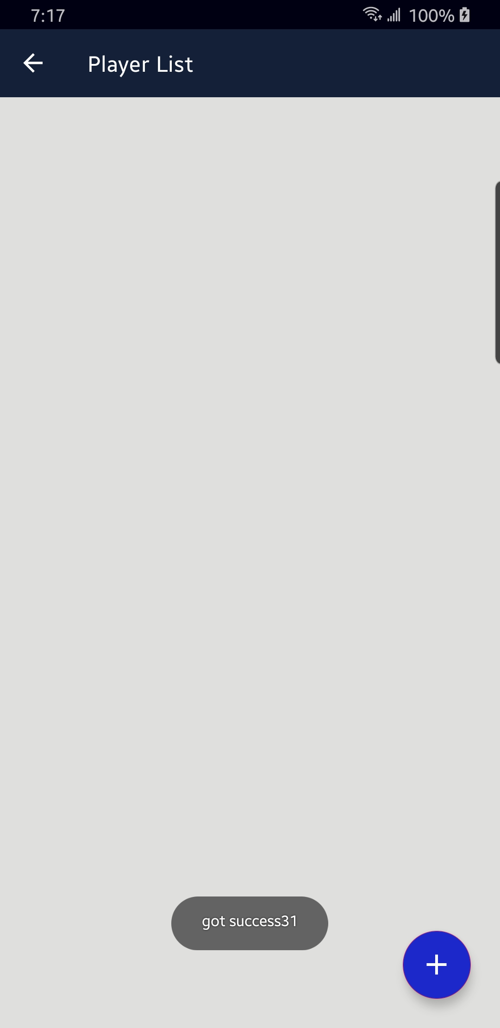
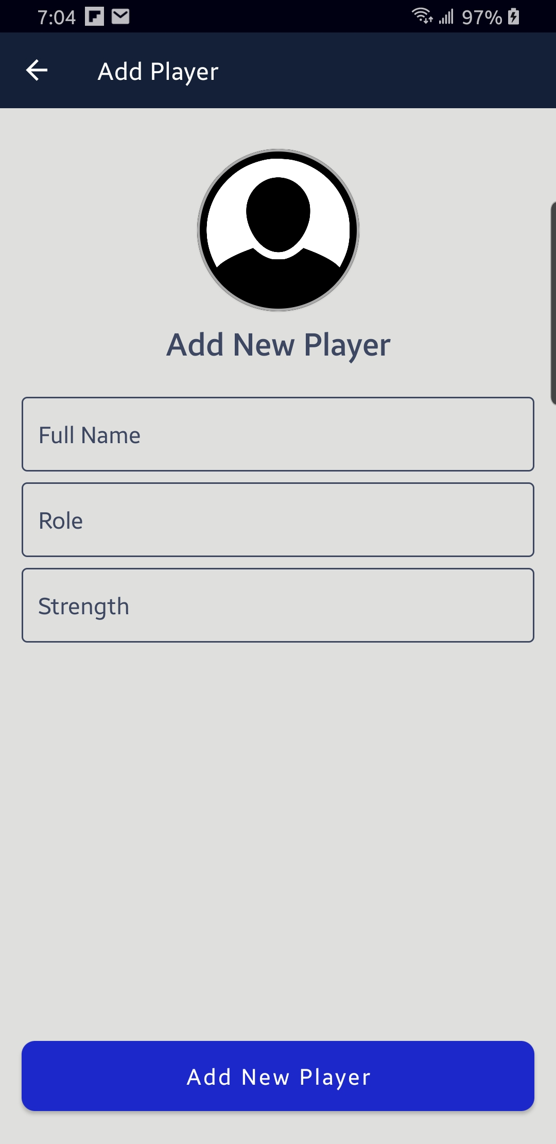
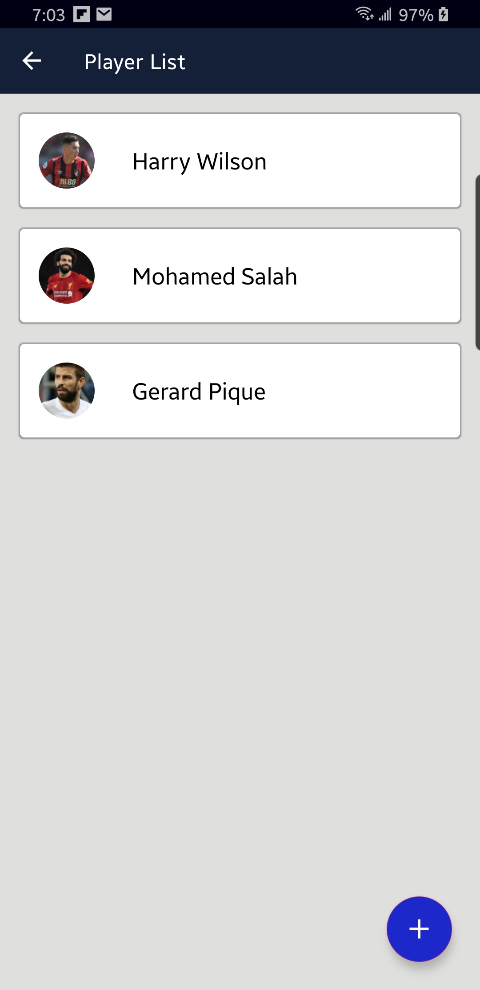

Slide 21
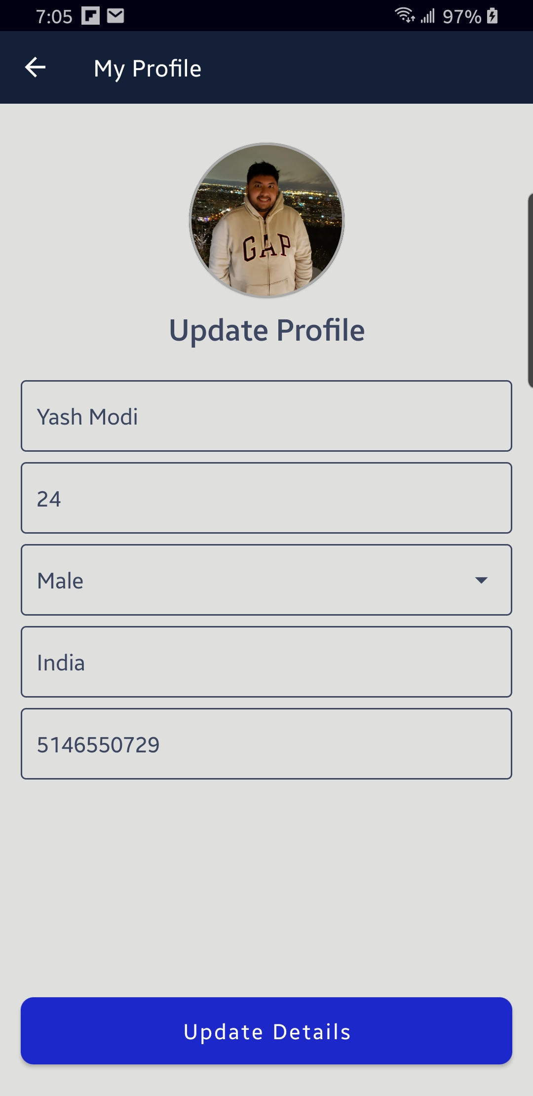
My Team displays the list of teams.
Player list displays the list of players from database.
My Profile let’s the user to edThey user’s profile.

Slide 22
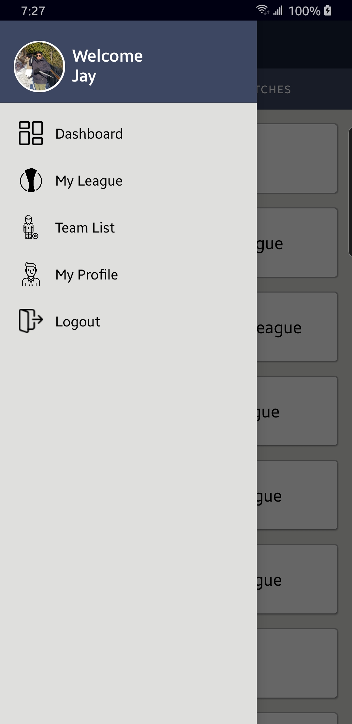
League Manager Drawer Screen
My League displays the list of User’s Leagues.
Team list displays the list of Team from database.
My Profile let’s the user to edit user’s profile.

Slide 23
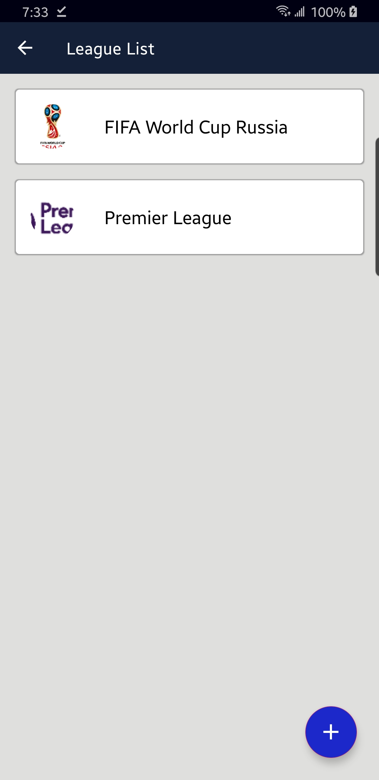
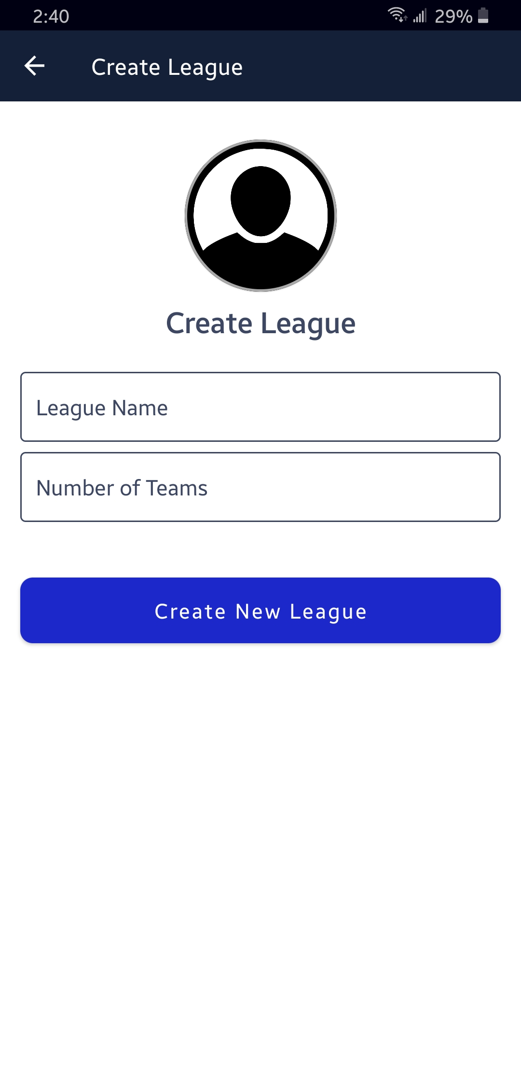



Slide 24
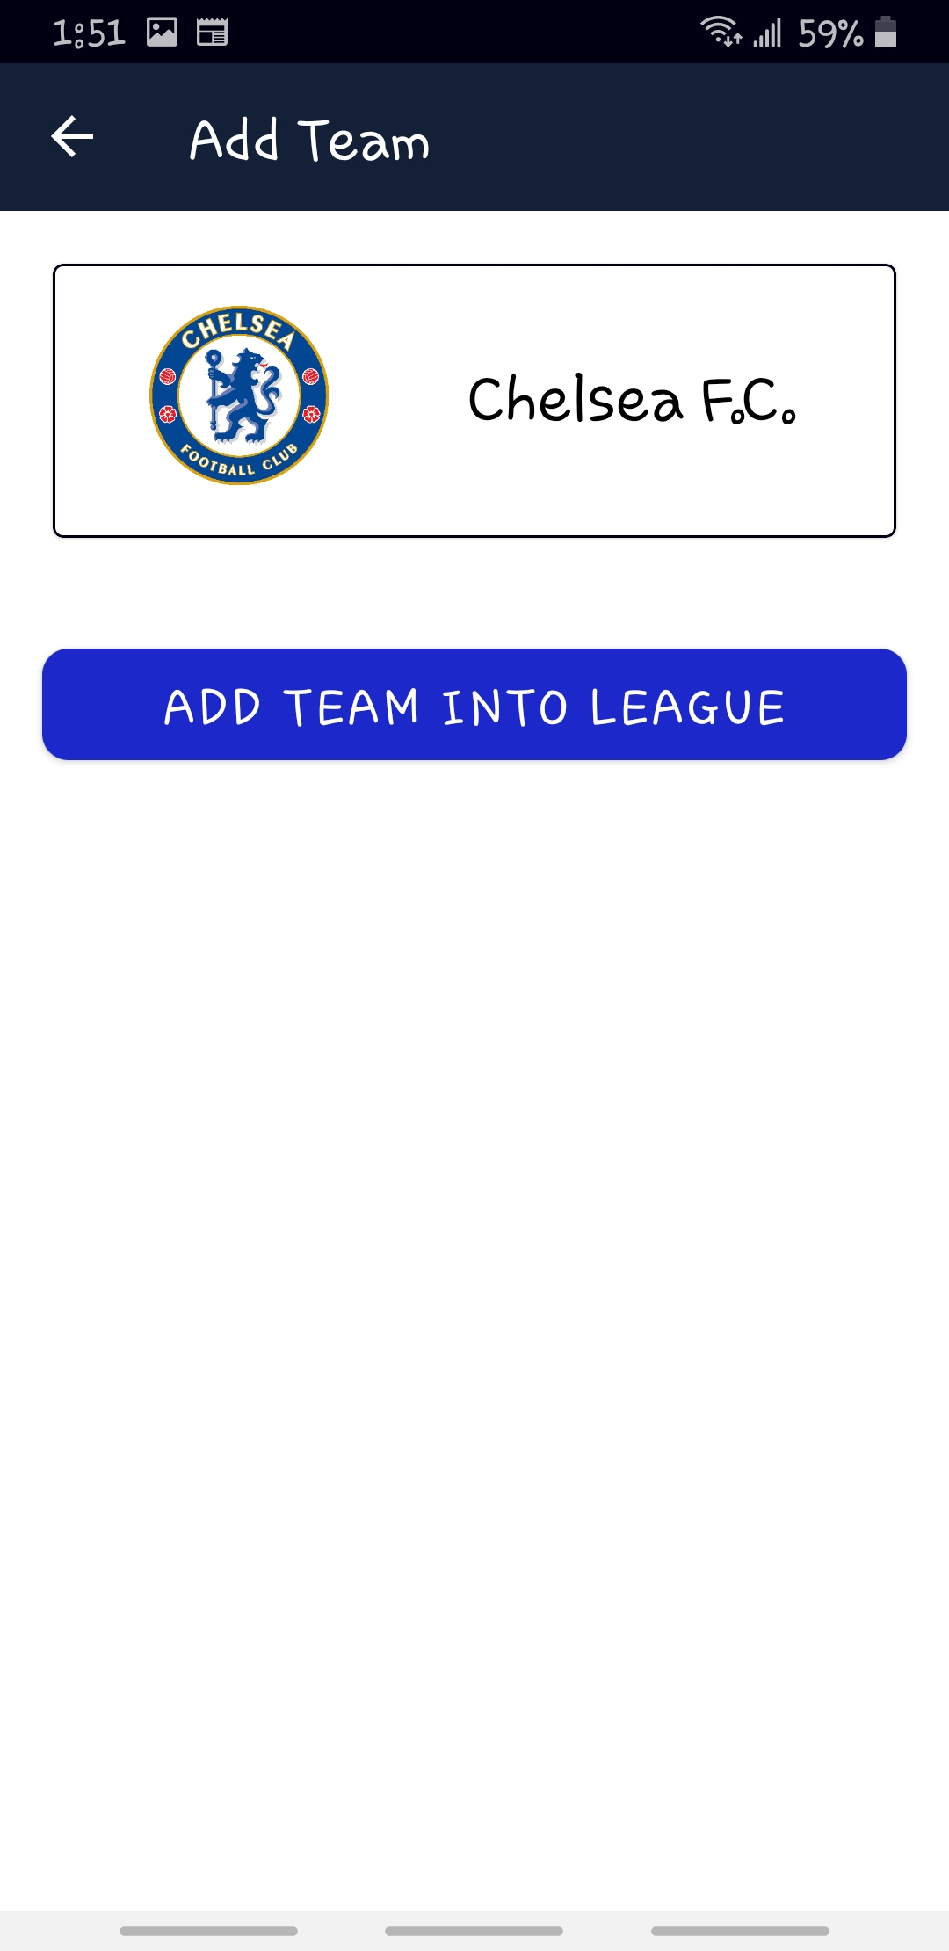

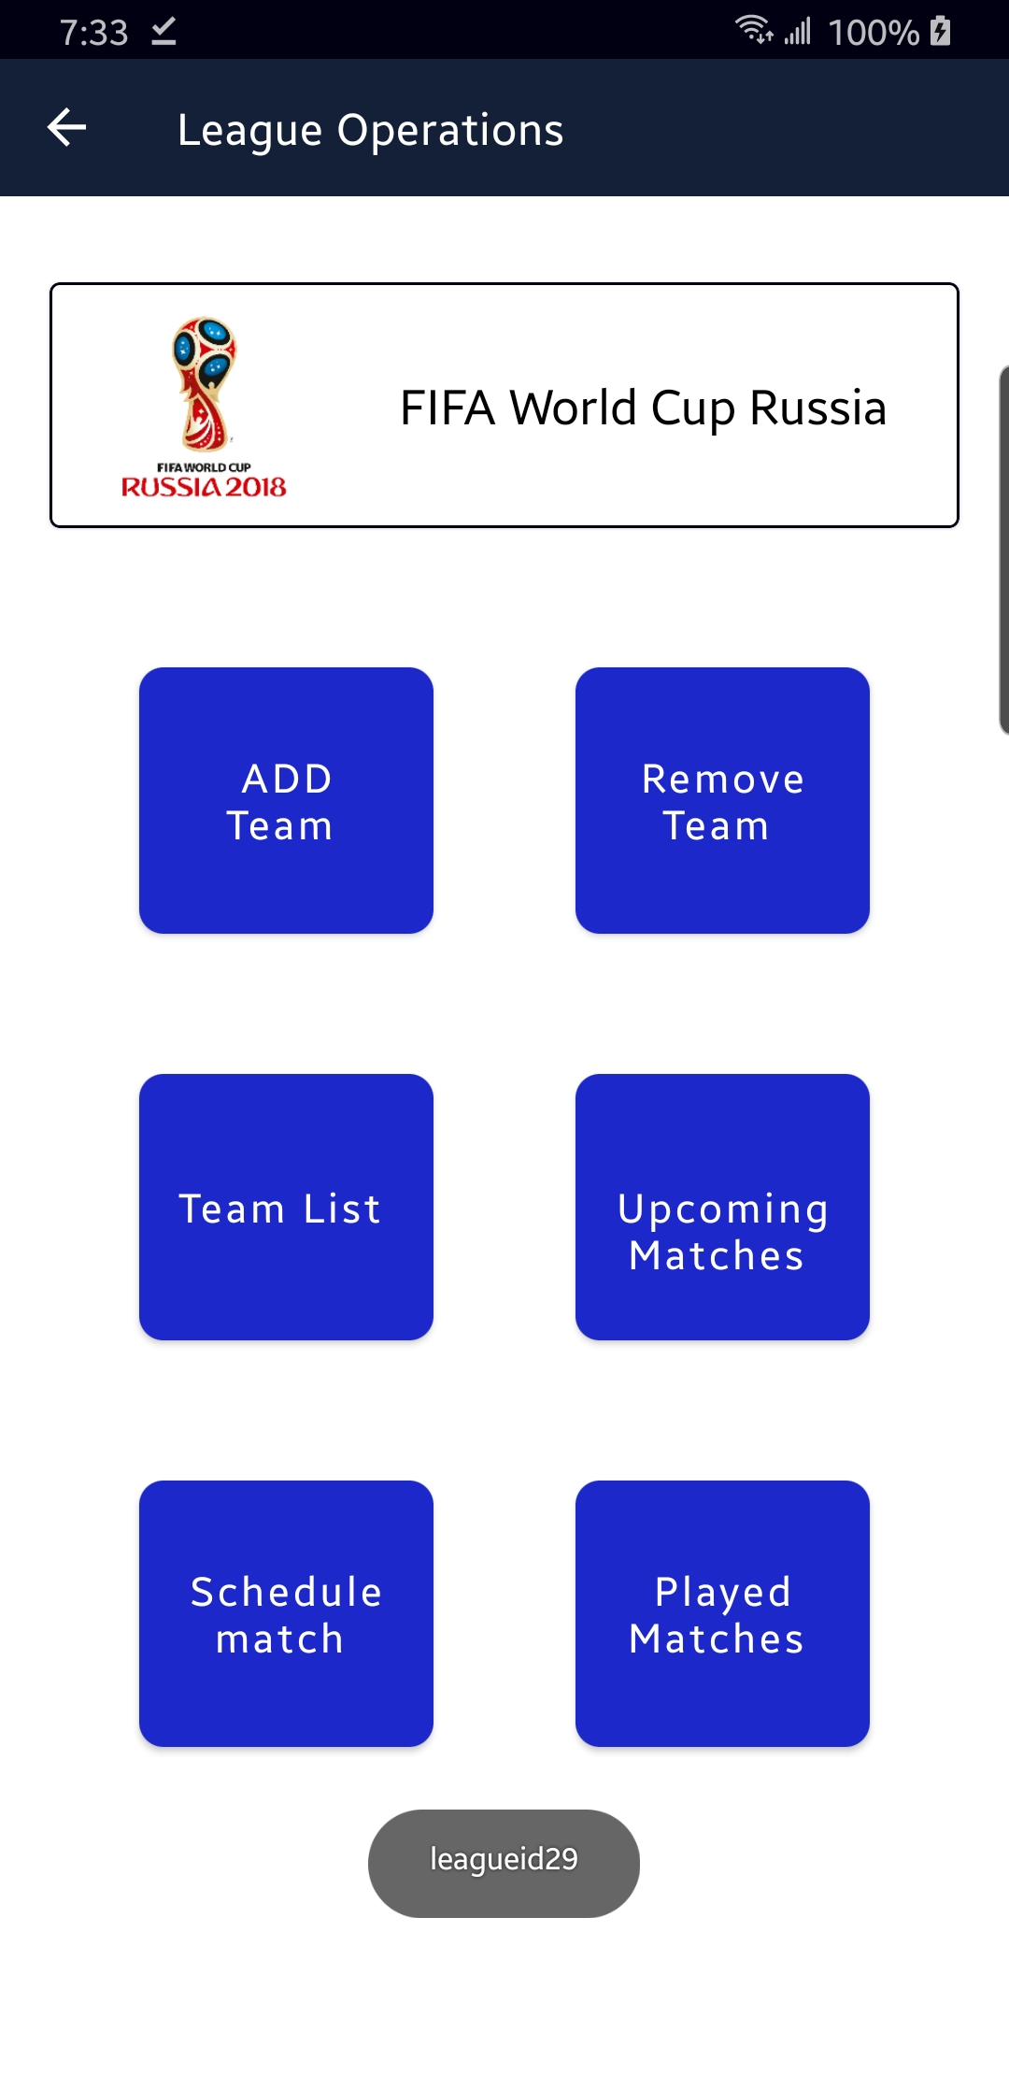
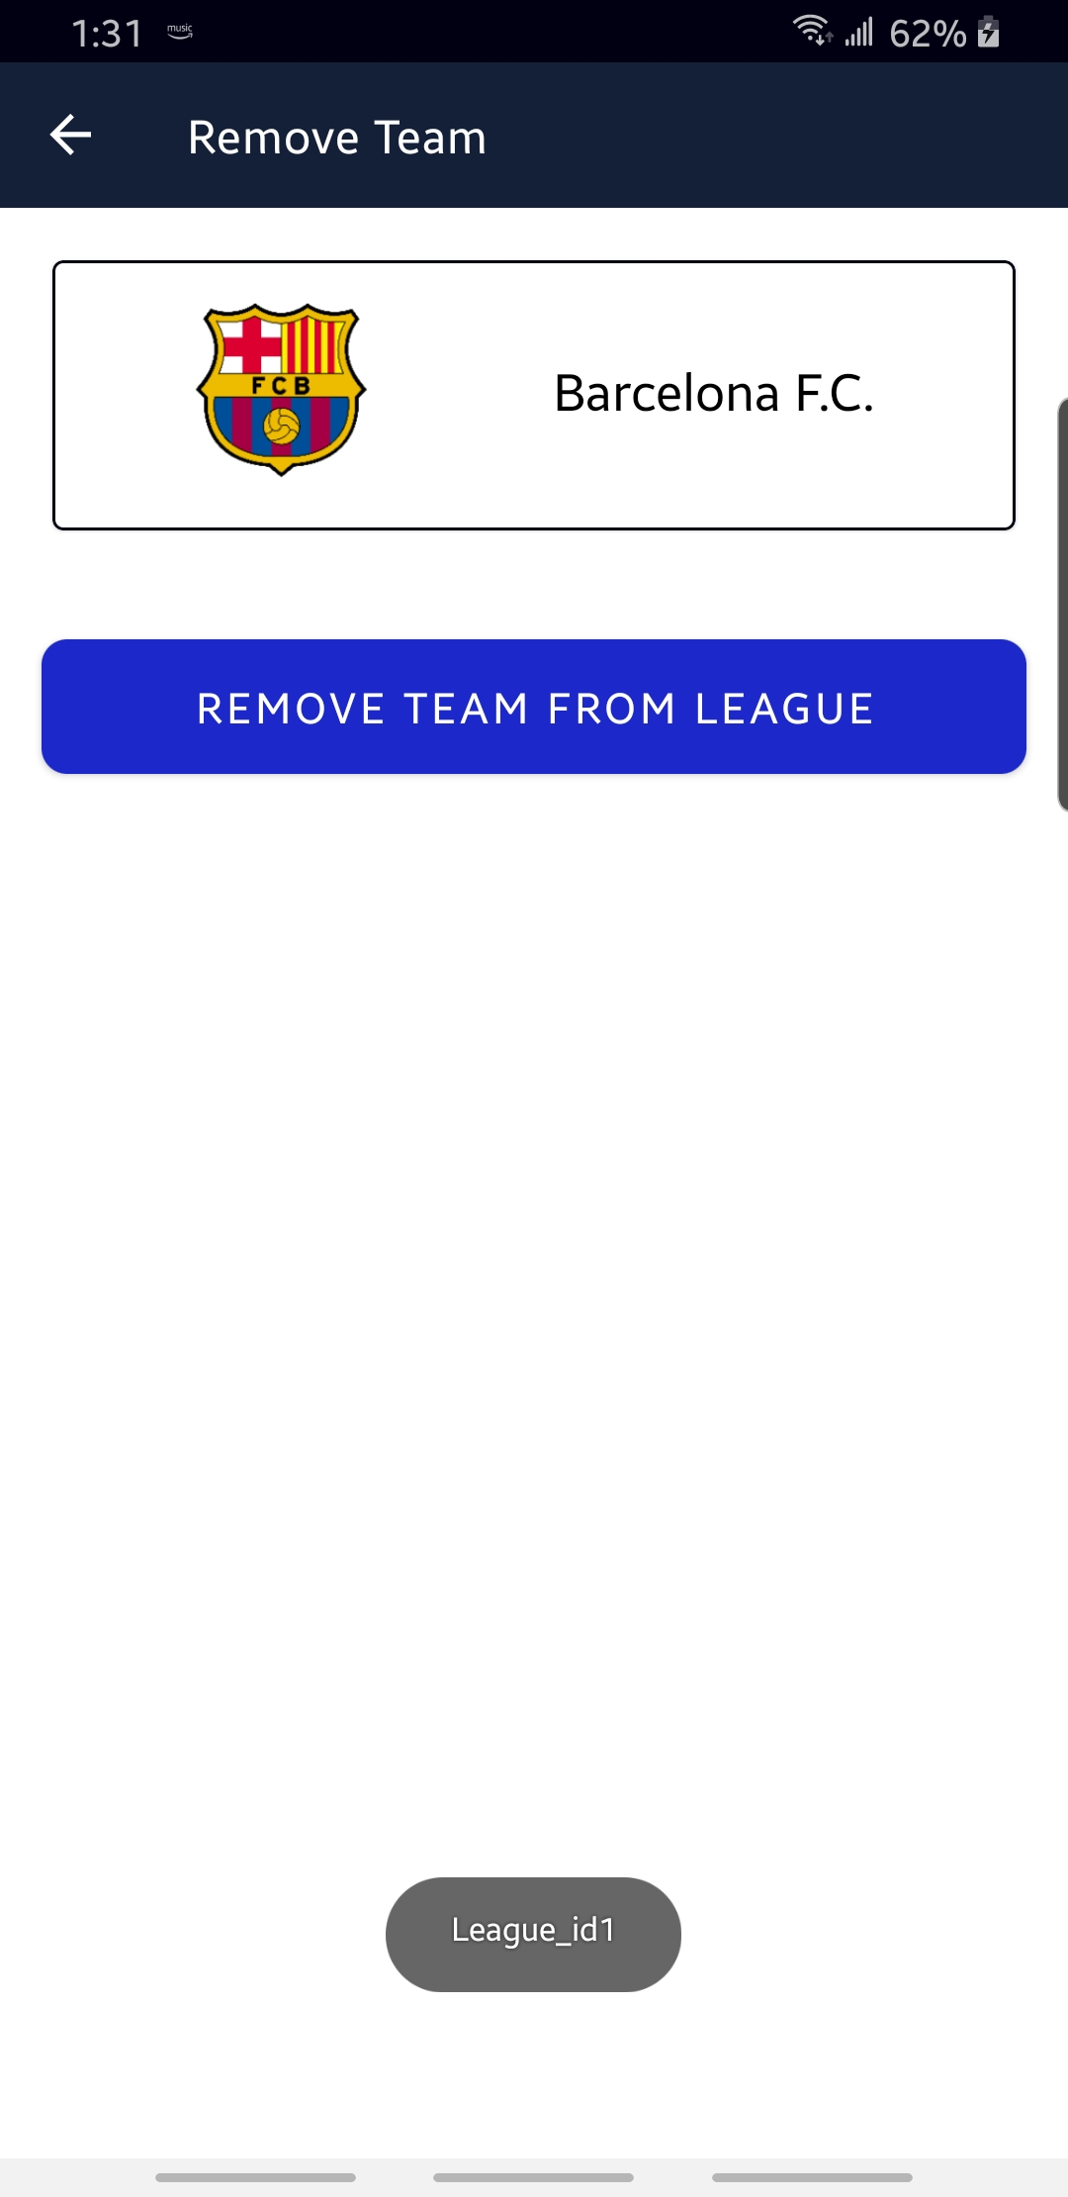

Slide 25
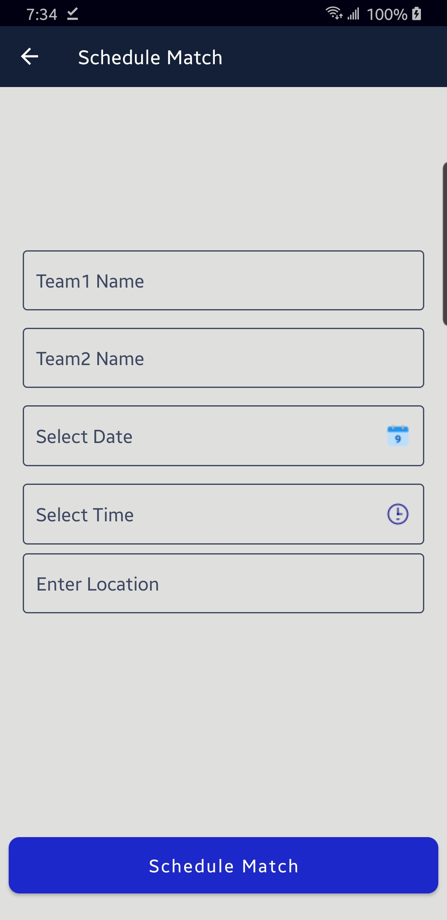
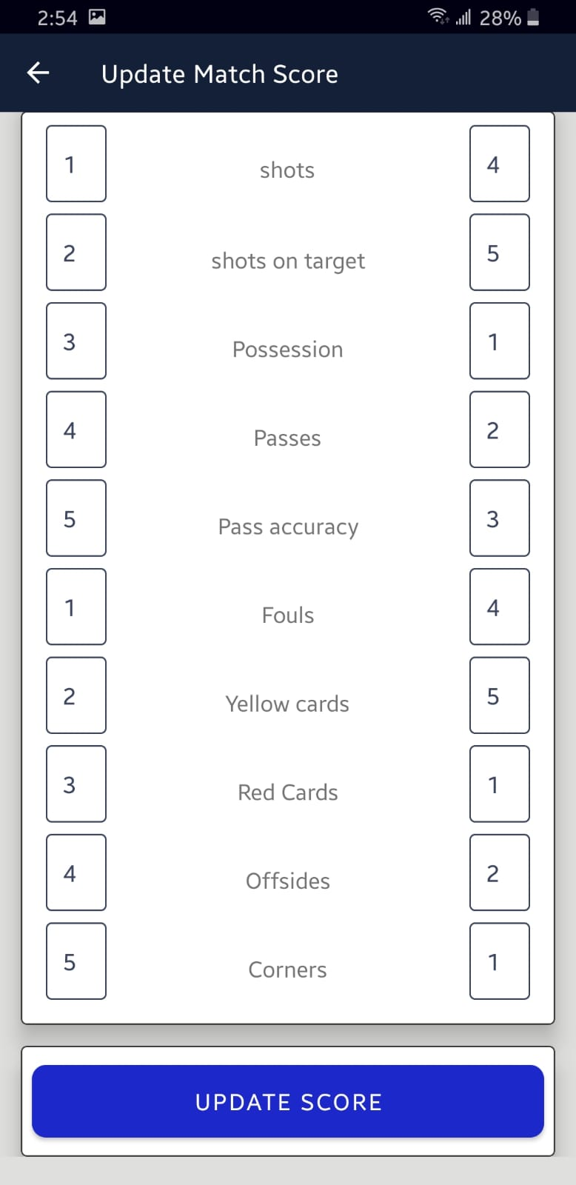

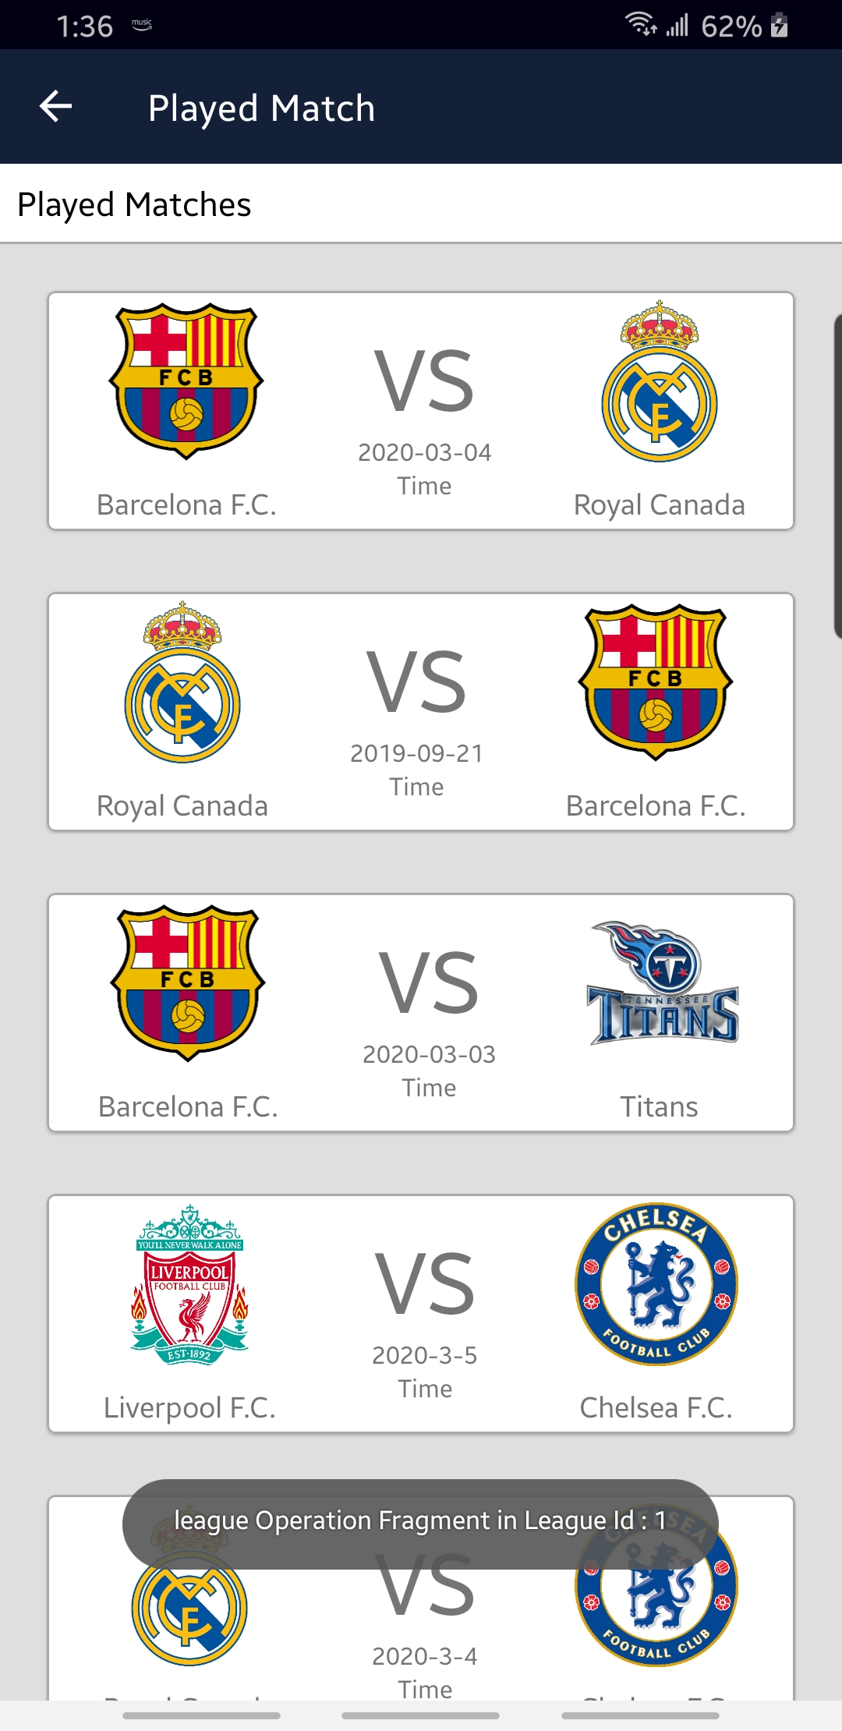

Slide 26
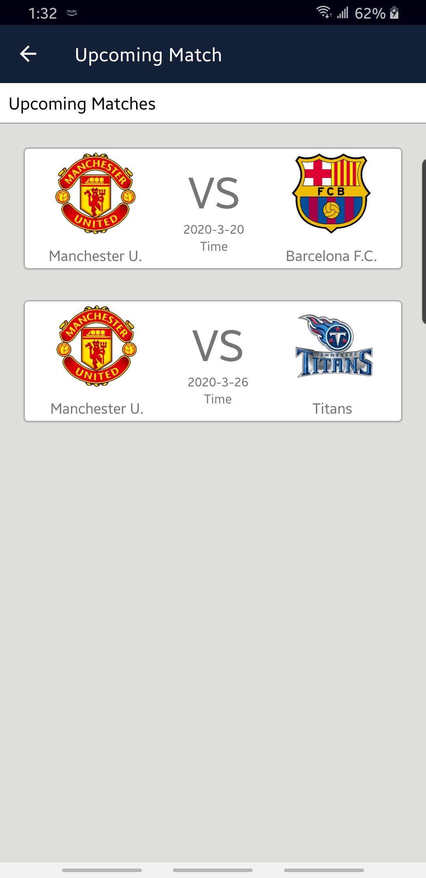
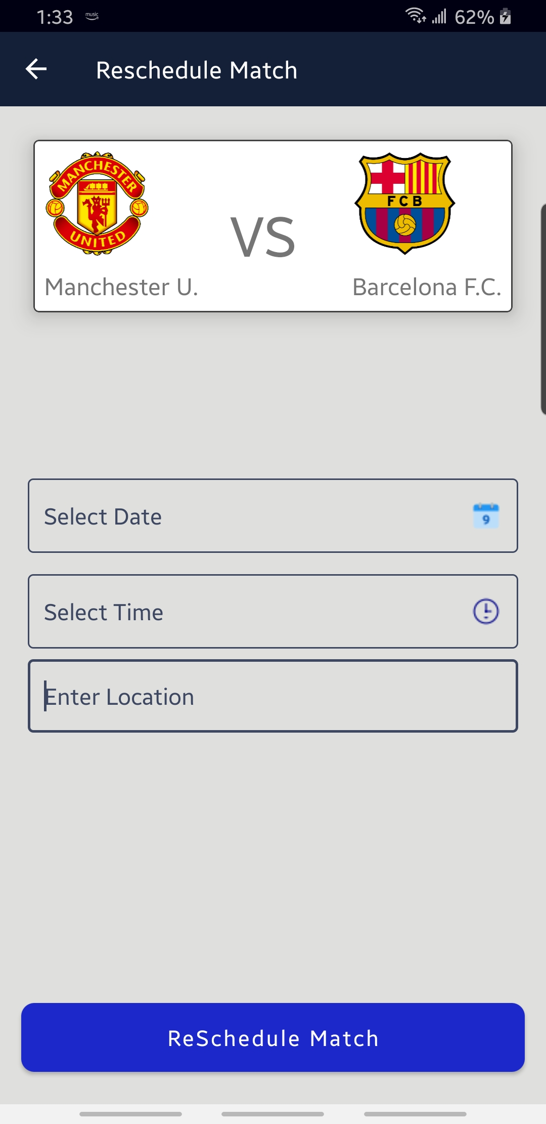
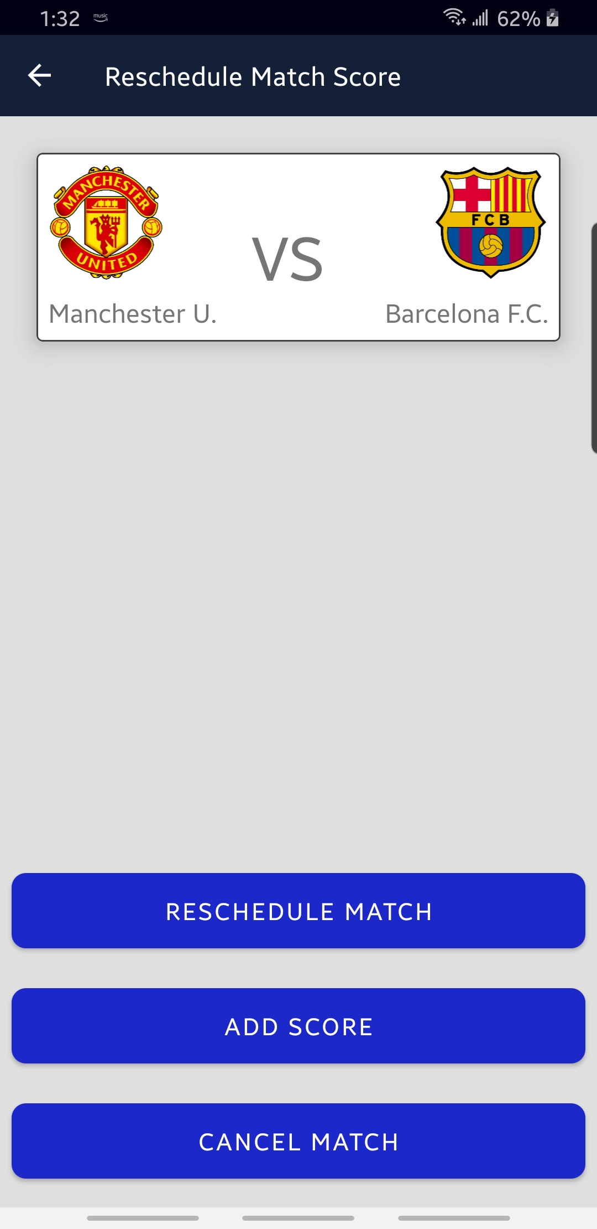
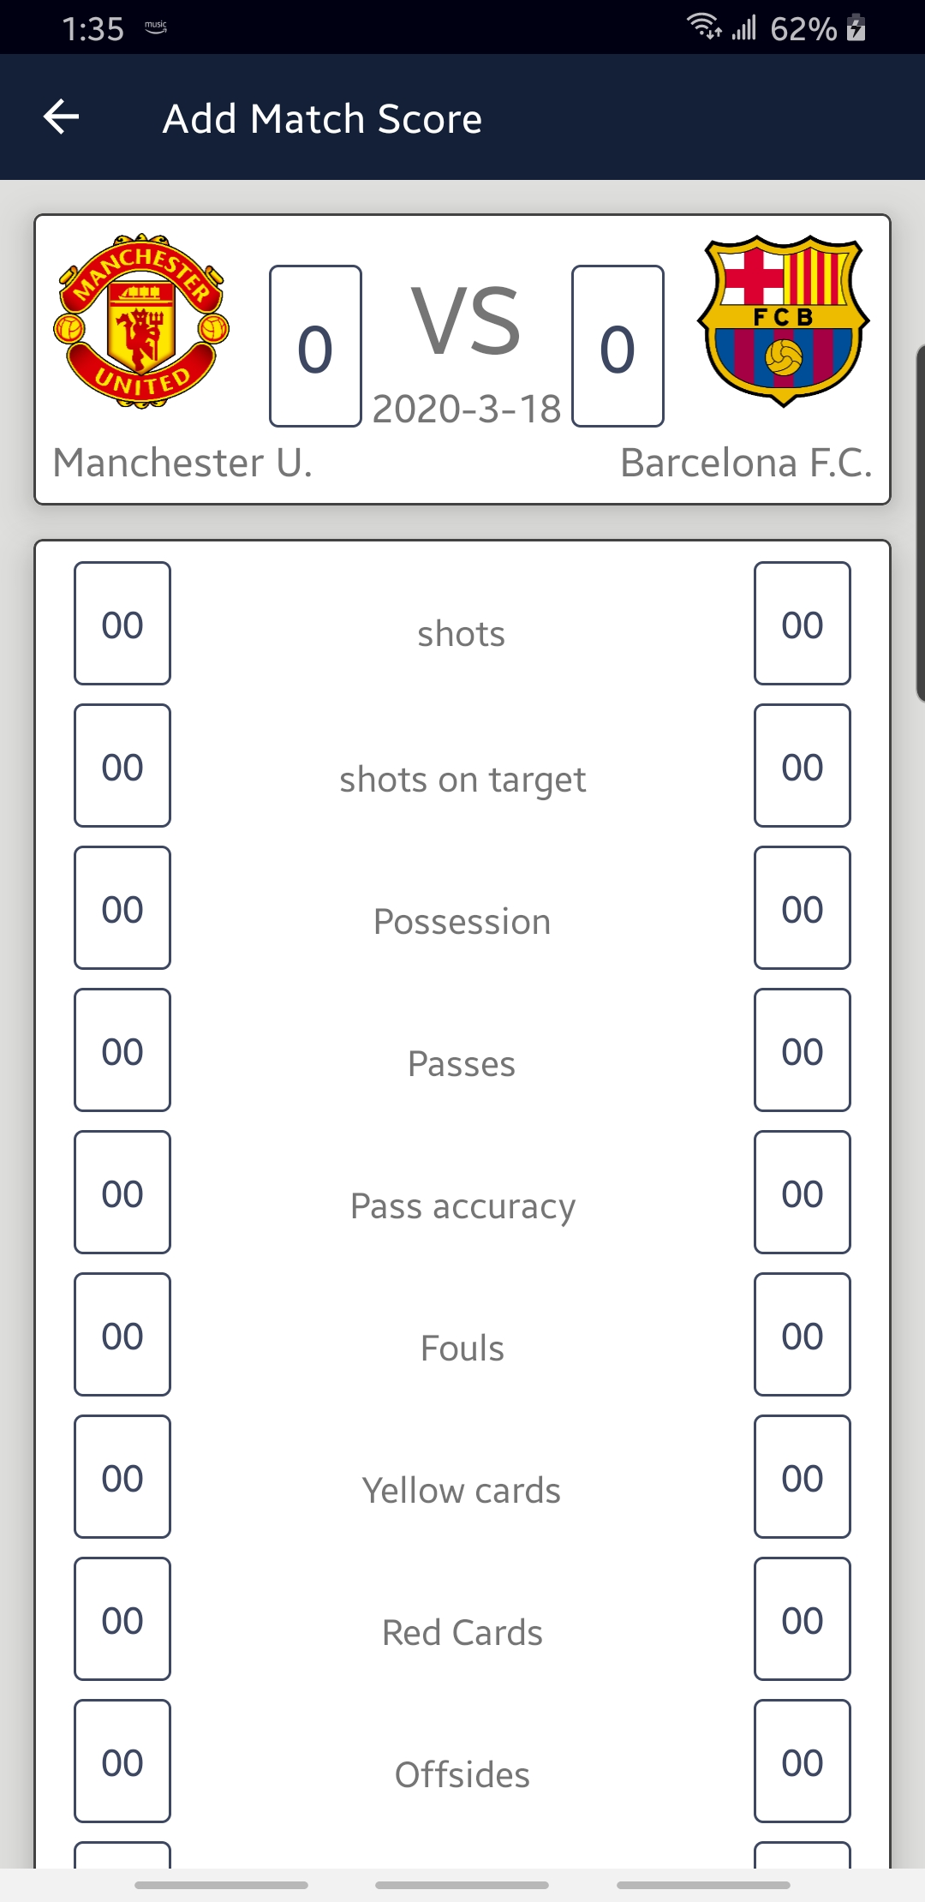

Slide 27
Difficulties Overcame
Issue: We decided to use OTP verification method with mobile number for user verification but we couldn’t because Firebase provides OTP verification to same mobile number which should be used as id.
Solution: Therefore, we decided to go with Email verification.
Issue: We tried to use Volley library for request handling with the purpose to learn Volley but as it was our first attempt It created issues in handling request queue for every API call and also, it was complicated for the post method calls.
Solution: Therefore, Retrofit was used, to which we were already familiar.
Issue: We tried to use mysql database server but it went down.
Solution: Therefore, we found new server called Clever cloud and used it for our application.

Slide 28
Future Enhancements
We would’ve added the deactivate account feature for Team manager and League manager.
We would’ve added the feature for Auto-Schedule Match.
We would’ve made more interactive response and less response time.
We would’ve added remove league feature.
We would’ve added more screens with detailing about leagues, teams and players.
We would’ve illustrated visual result for score by providing graphs and would have made comparisons between teams and players.

Slide 29
Soccer Alliance App Video Link
https://www.youtube.com/watch?v=UMkansUOm6o

Slide 30
Thank You!

